Slide 1

Knowledge Exchange and
Learning Workshop
Learning Labs
Annual Programme Workshop
20th-23rd September 2022
Blantyre, Malawi

Slide 2

What is a Multistakeholder Platform (MSP)
…….. a space or activity that brings together a
very diverse range of organizations and
individuals to address a specific issue that
affects them.

Slide 3
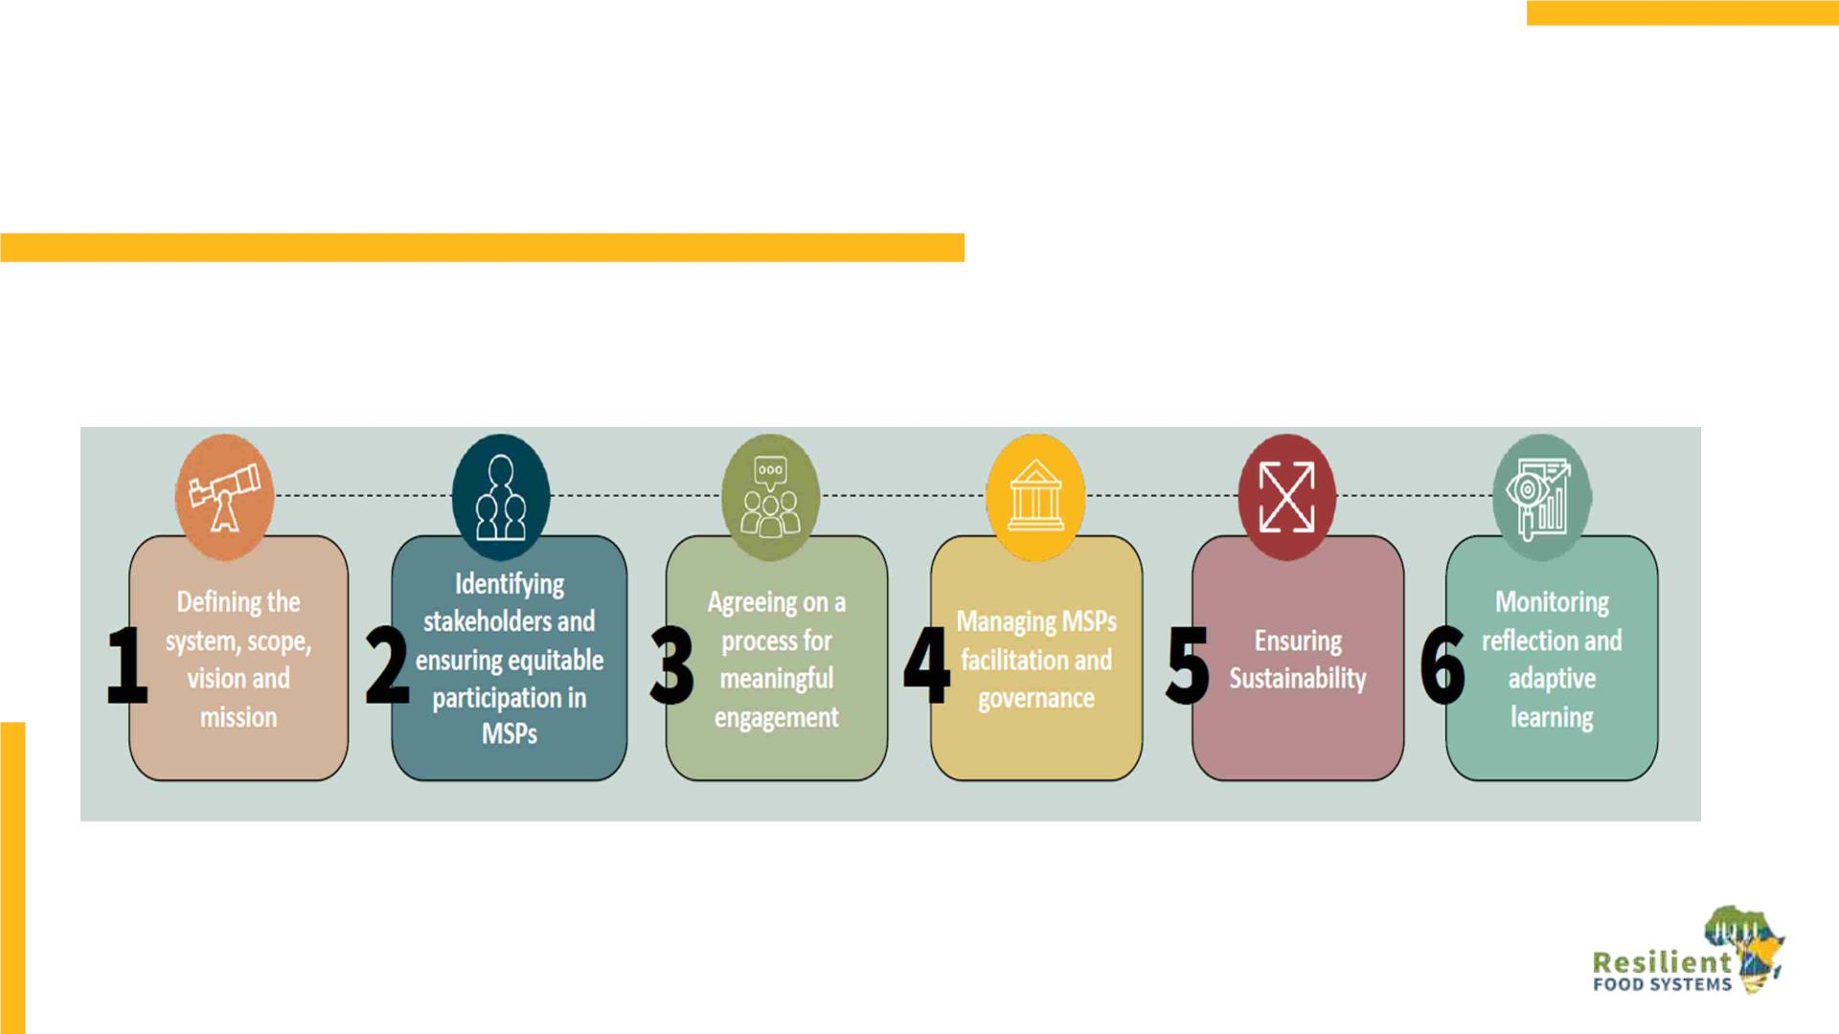
Stages in the MSP Process (SHARED framework)

Slide 4

The Ethiopia –Uganda case stories: Lab 1
Experiences on Creating and Managing Functional
and Effective Multi-Stakeholder Platforms
MSP Engagement Process, Int’d Landscape
Mgmt. and FS project of Ethiopia

Slide 5

Problem: Highly degraded and vulnerable environments where small holder farmers depend;
Associated erosion and declining soil fertility; Prevalence of food insecurity due to low food
production
Project Title: Integrated Landscape Management to Enhance Food Security and Ecosystem Resilience in
Ethiopia
Project Duration: 2017-2022
Project goal: To enhance long-term sustainability and resilience of food production systems
by addressing the environmental drivers of food insecurity in Ethiopia.
Component 1 Institutional frameworks for enhanced biodiversity and ecosystem goods and
services within food production systems
Component 2 Scaling up the Integrated Landscape Management approach to achieve
improved productivity of smallholder food production systems and innovative
transformations to non-farm livelihoods
Component 3 Knowledge Management, Learning, Monitoring and Assessment
Strategy: The project applies an integrated approach that tackles both environmental and
socio-economic drivers of food insecurity. It focus on integrated landscape management
(ILM) to achieve food production resilience in landscapes under pressure. It combines land
management choices and Integrated Natural Resources Management (INRM) with water-
and climate-smart agriculture, value chain support and gender responsiveness

Slide 6
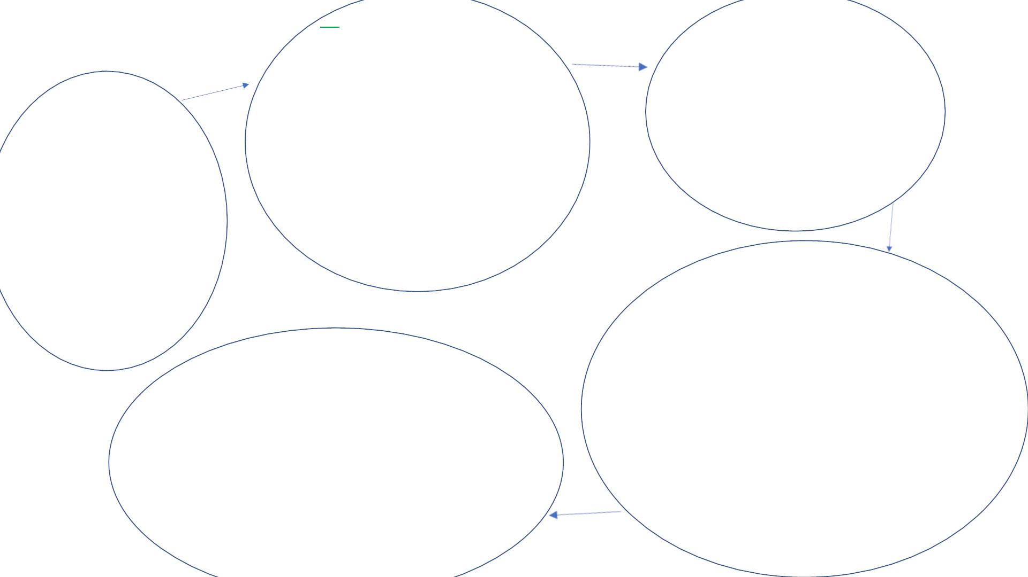
2. Identifying stakeholders:
ü National level=27 members
ü District level =7 to 11
members
MSP Engagement Process,
Ethiopia
3. Agreeing on a process
for engagement
• Training and
ü Organize context based
additional committees;
• Technical teams. Members
from relevant offices
• CWT ( 61 CWT)
• Gender team at District &
Community levels
Awareness:
• project concepts,
• approaches,
1. Identifying the
System:
• Overall
•
project components
assessment
• Situation
analysis
• financial guidelines
• Potentials,
opportunities
and risks drafted
4. Managing MSP, facilitation and
governance
v TOR developed which include:
Roles and responsibilities
• National level focus on
strategic directions and major
out puts
5. Ensuring Sustainability
• Maintain Regular meetings;
• National level undertake meeting twice
a year.
• District level at least once per month
• Update the members due to turnover
• Organize need based training;
• Undertake objectives-based experience
sharing visits at all levels ( national,
regional and woreda)
• District level on detail
activities and review their
plan quarterly
v Discussions conducted and get
common understanding
• Monitoring feedback (physical)

Slide 7
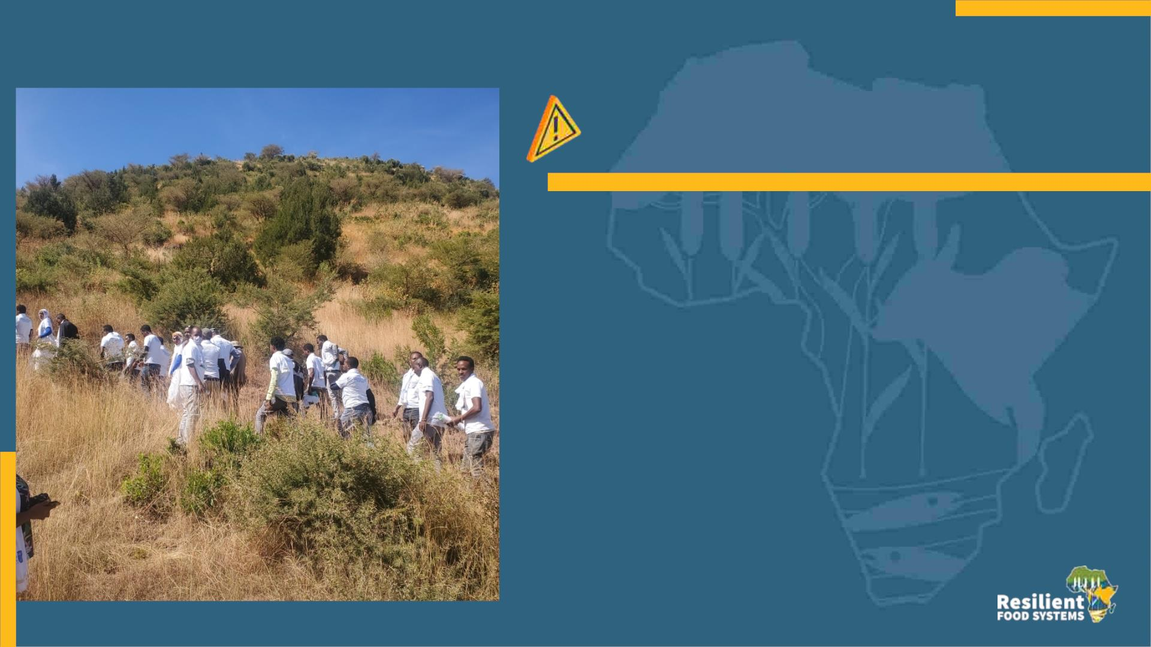
Challenges
• Other priorities due to the fact that most of the
MSP members are politically assigned;
• Frequent turnover; which require frequent
awareness and capacity building.
• Conflict in some areas

Slide 8

Lesson learned:
v MSP for project guidance are key to integrate
different stakeholdersand to enhance a bottom-up
approach;
v Creativeness improved to come up with new
ideas, development agendas;
v Capacity developed in project management;
v Decision making power improved at local.
v MSP is very important when working in different
regions, ecosystems, and socio – economic contexts
in different productive sectors, which a “one size fits
all” recipe is not proper.
v MSP engagement is very important for:
• identification of community priorities
• improvement and development of
ownership
• Additional resources were also
mobilized

Slide 9
Learning Lab 1: Multi-stakeholder engagement processes
Experiences on Creating and Managing Functional
and Effective Multi-Stakeholder Platforms in
Ethiopia and Uganda
Co-led by Ethiopia and Uganda in collaboration with UNEP, FAO, ICRAF & UNDP-AGRA

Slide 10
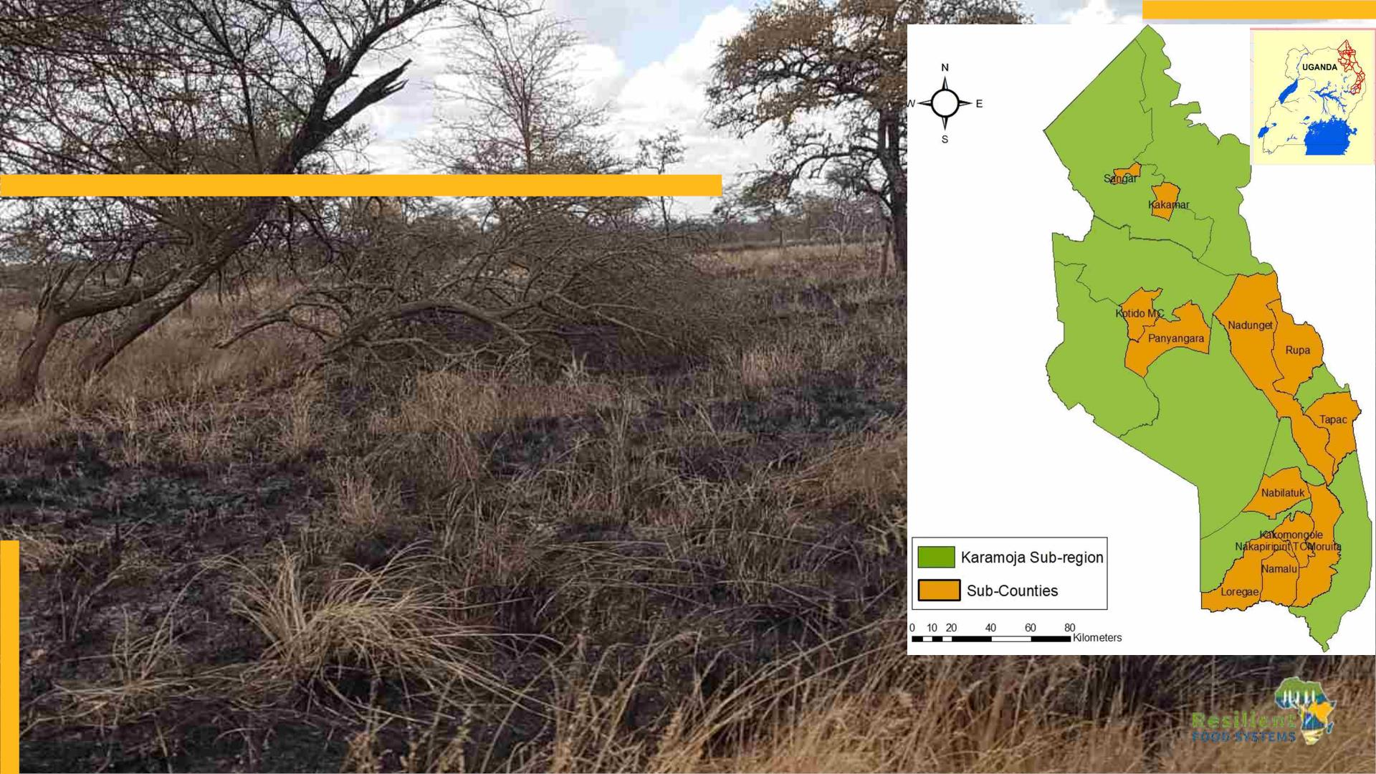
Brief background
• The Karamoja sub-region in northeastern Uganda faces
chronic food insecurity resulting from combined
pressures of hazards and stresses including
environmental degradation and climate change.
• Some of the main barriers to achieving environmental
sustainability and food security include:
• Insufficient policy and legal guidance on natural
resources management.
• Fragmented technical capacity to support food
production.
• Lack of integrated coordination mechanism at the
district level.
• Weak evidence base to support decision-making
• Socio-cultural barriers to development of stronger
value chains

Slide 11

Project Approach
The project objective is to contribute to enhancing long-term
environmental sustainability and resilience of food production
systems in the Karamoja sub-region.
Outcome 1 : Supportive policies and incentives in place to support improved crop and
livestock production, food value-chains and INRM (UNDP/MAAIF)
Outcome 2: Increased land area and agro-ecosystems under integrated natural
resources management (INRM) and SLM practices for a more productive Karamoja
landscape (FAO/MAAIF)
Outcome 3: Framework in place for multi-scale assessment, monitoring and integration
of resilience in production landscape & monitoring of GEBs (UNDP/MAAIF)

Slide 12

Establishment of district level multi-stakeholder platforms
Objective: To promote a shift towards more integrated, collaborative, ecologically sustainable and multi-
sectoral approaches to improved crop and livestock production along selected food value-chains
Participatory assessment of
existing platforms, coordination
mechanisms and indigenous
groups
Capacity development on Value
chain assessment and mapping
Management and Sustainability
mechanisms/Impacts
• No inclusive functioning
multi-stakeholder fora
and committees on INRM
in place,
• 16 (3F;13M) district and partner
technical staff trained on Value
chain Greening by AGRA/UNDP.
• ToT on MSPs conducted for 10
(5F, 5M) National Value Chain
Facilitators by FAO/SHARED
team
35 land use plans developed to
guide INRM by communities.
A team of National value chain
facilitators established.
Formalization of the MSPs along 4
priority commodity value chains.
Opportunities for value chain
• Some
coordination
mechanisms exist at
district and regional
levels in form of
• 4
Priority
Agricultural
investments
identified
per
Commodities profiled for value
chain development,
priority commodity and relevant
stakeholders trained on proposal
development for funding (e.g.
government
led
• 6
committees and partner
led-advocacy forums.
commodity-products
including, cassava flour, Honey,
Bees wax, Fermented Sorghum
Beverage, Sorghum Flour and
Maize flour identified for MSP
development.
.
ABiTrust).

Slide 13
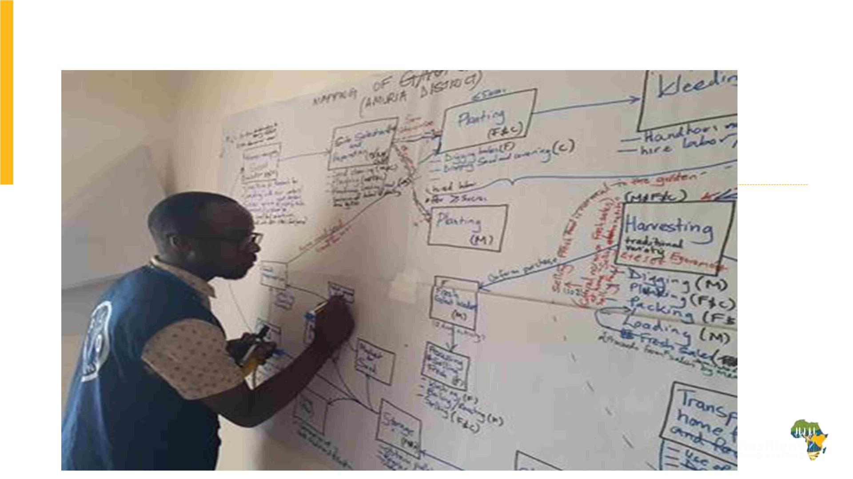
Value chain mapping chain

Slide 14
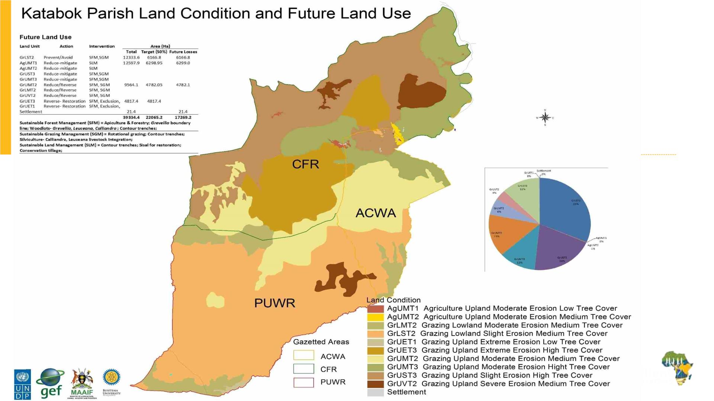

Slide 15

Challenges and Lessons learnt
• Insecurity and prolonged dry conditions in the region has limited stakeholder
engagements and affected agricultural production as well as trade.
• Absence of existing inclusive MSPs in Karamoja sub-region has slowed down
progress in the establishment of strong MSPs along selected value chains
• The predominantly subsistence nature of the production systems in Karamoja
is not attractive to private sector investment to support development of agro-
pastoral value chains.
• Building strong technical capacity in local government and development
partners on managing multi-stakeholder processes is critical in establishing
functional and effective MSPs.
• Increasing access to rural finance, incentives and building strong farmer
instirutions are essential in stimulating investment towards sustainable,
market oriented and diversified production for resilient livelihoods

Slide 16

Engaging .. to address institutional
and policy barriers
Component 1

Slide 17
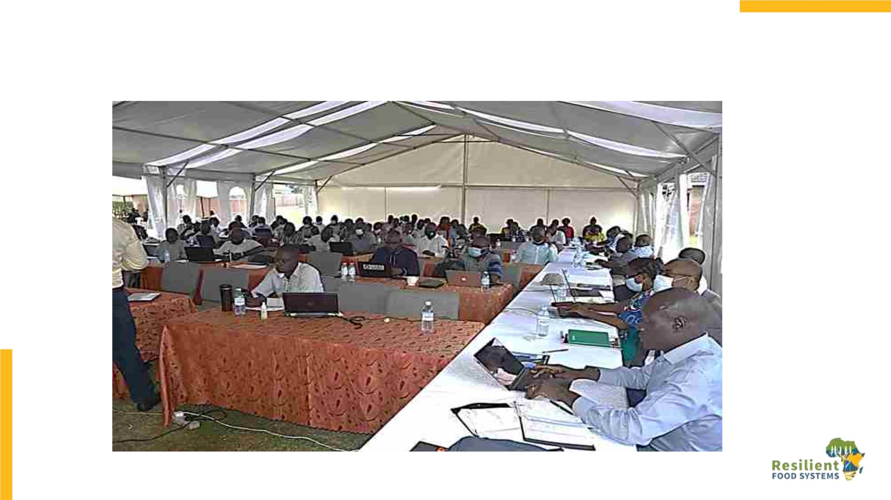

Slide 18
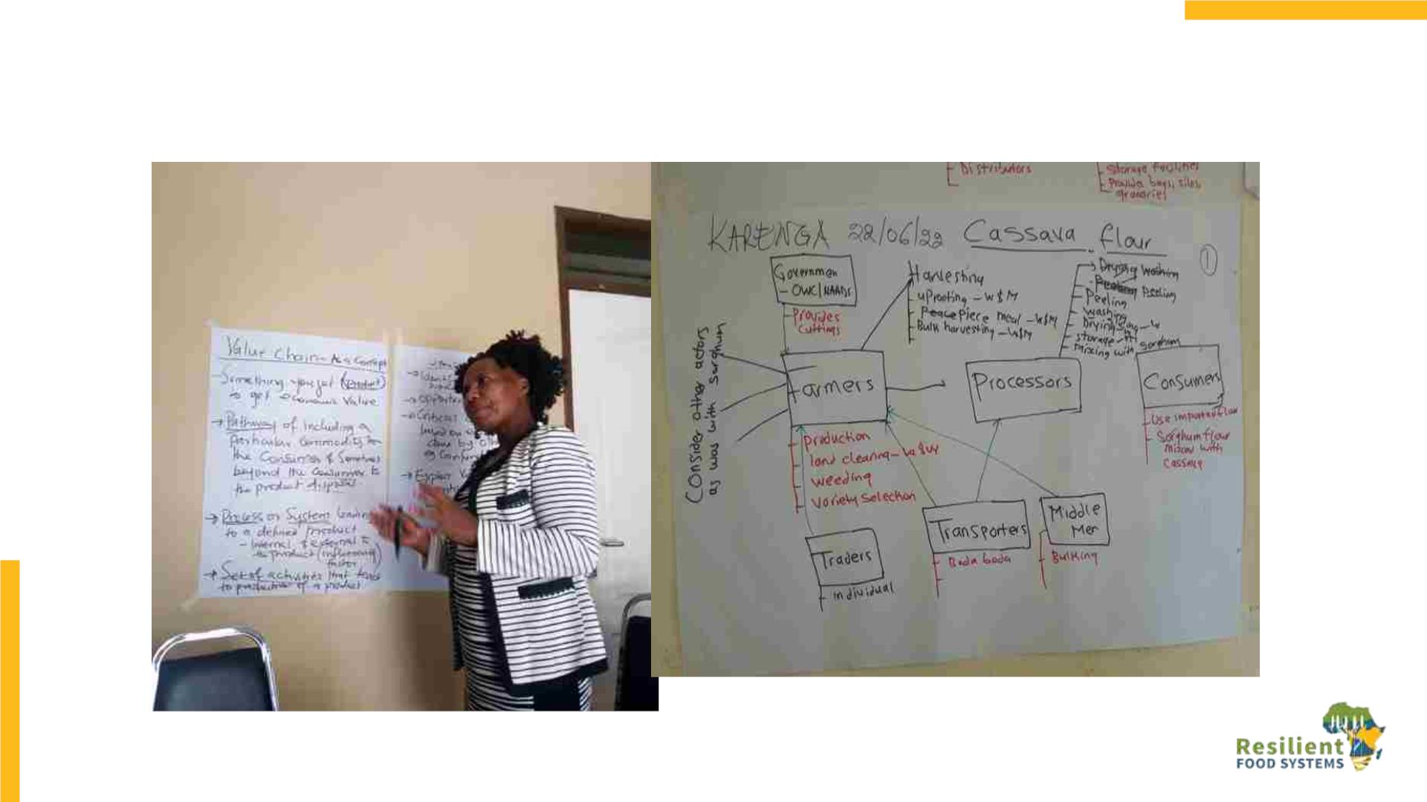

Slide 19
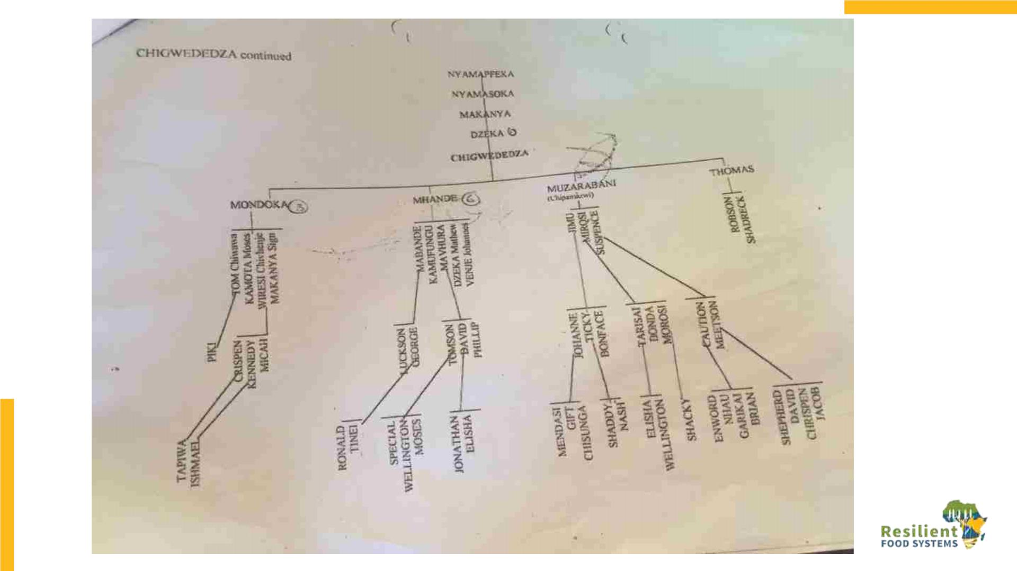

Slide 20
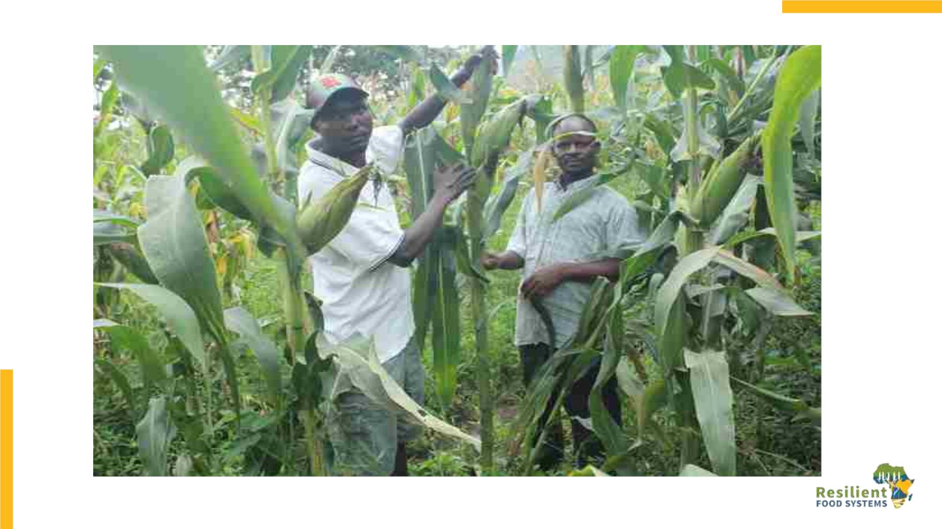

Slide 21
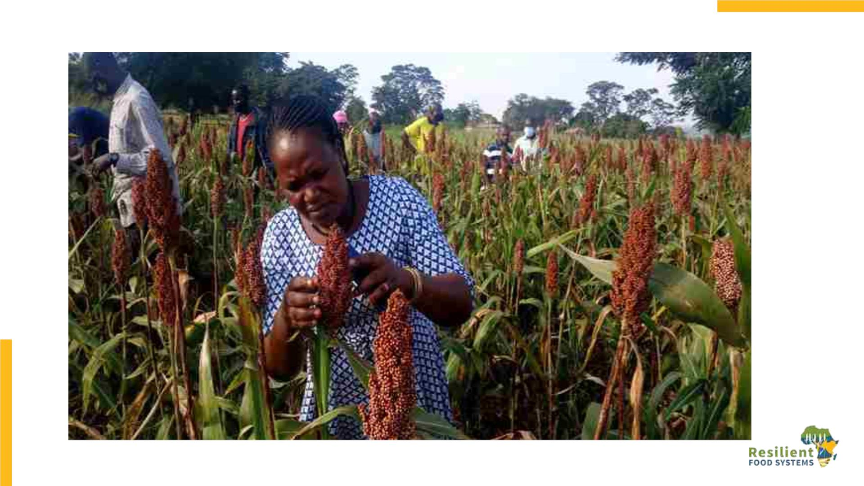

Slide 22
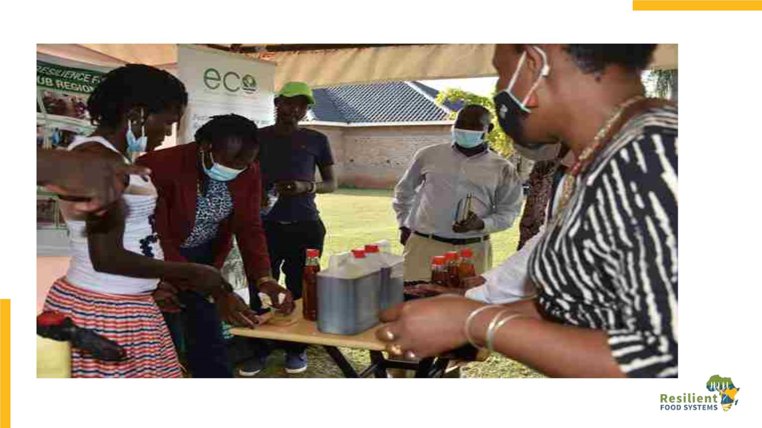

Slide 23
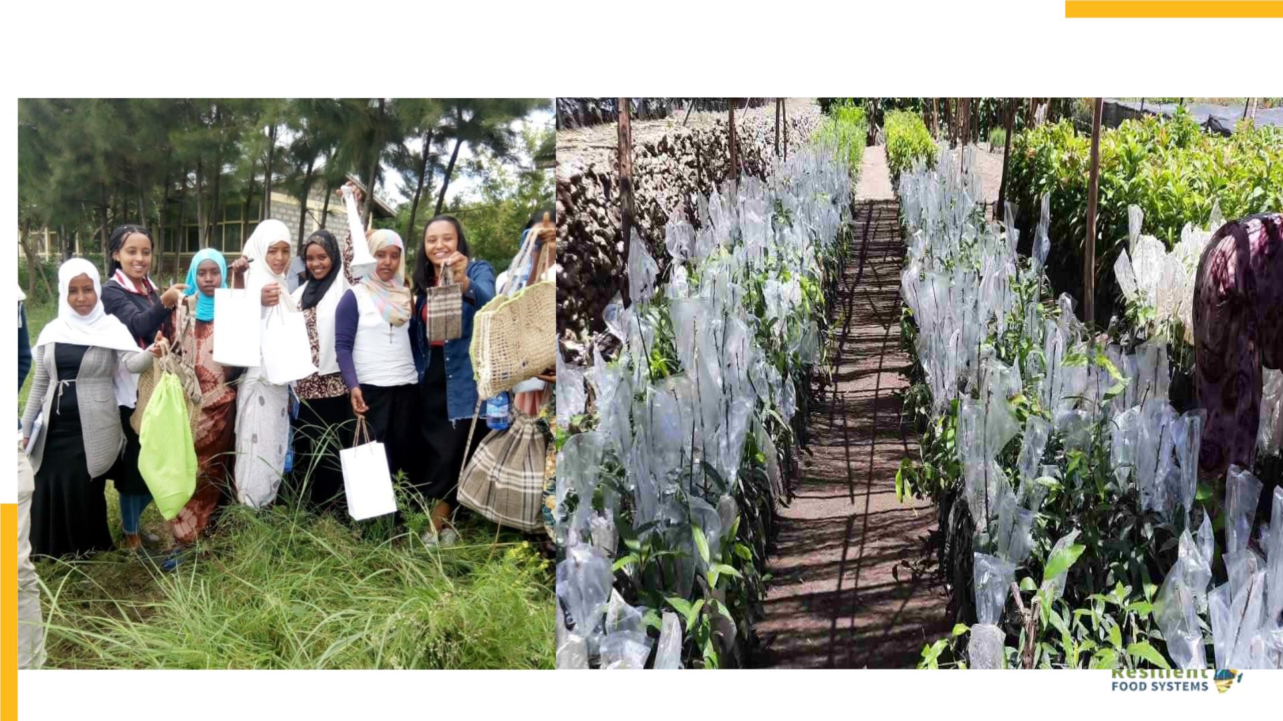

Slide 24
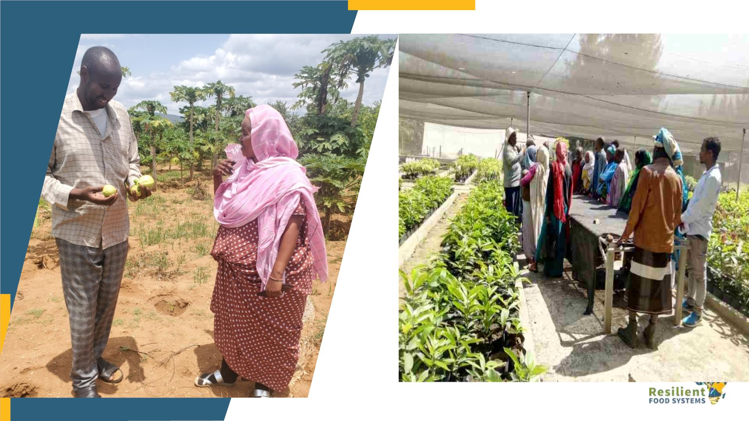

Slide 25
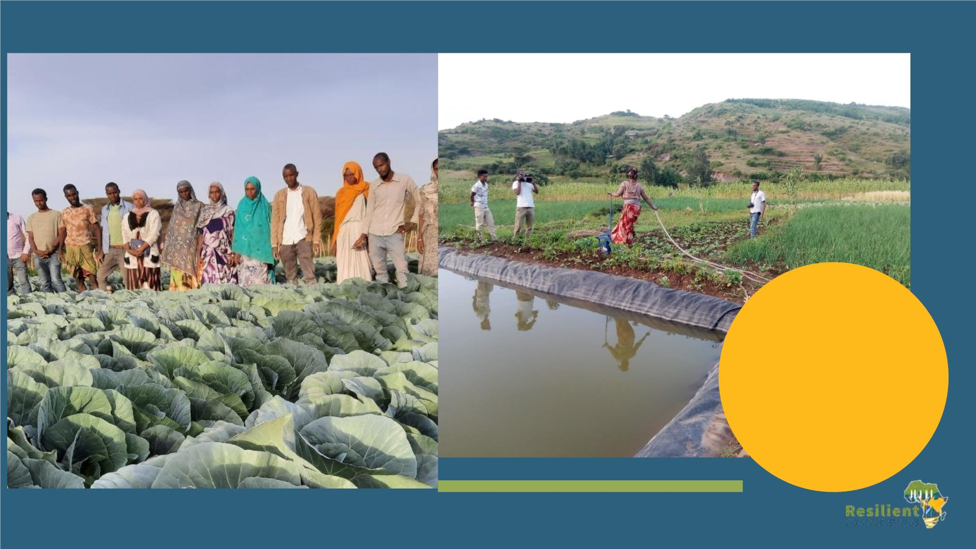
Model Women
farmer irrigating
her vegetable
from her water
bank, at Doba
site

Slide 26
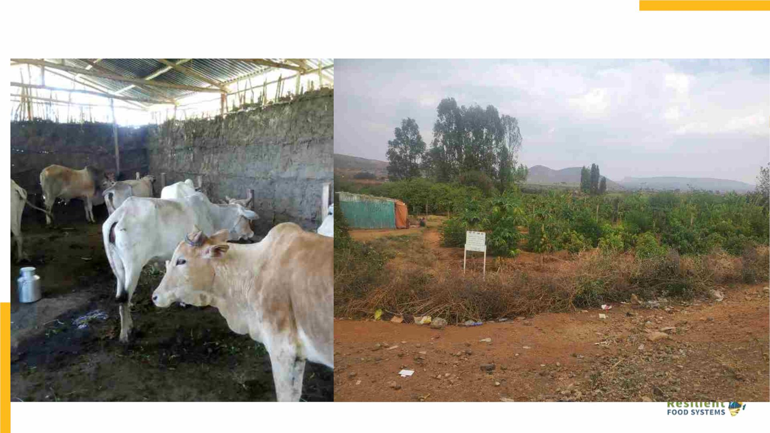

Slide 27
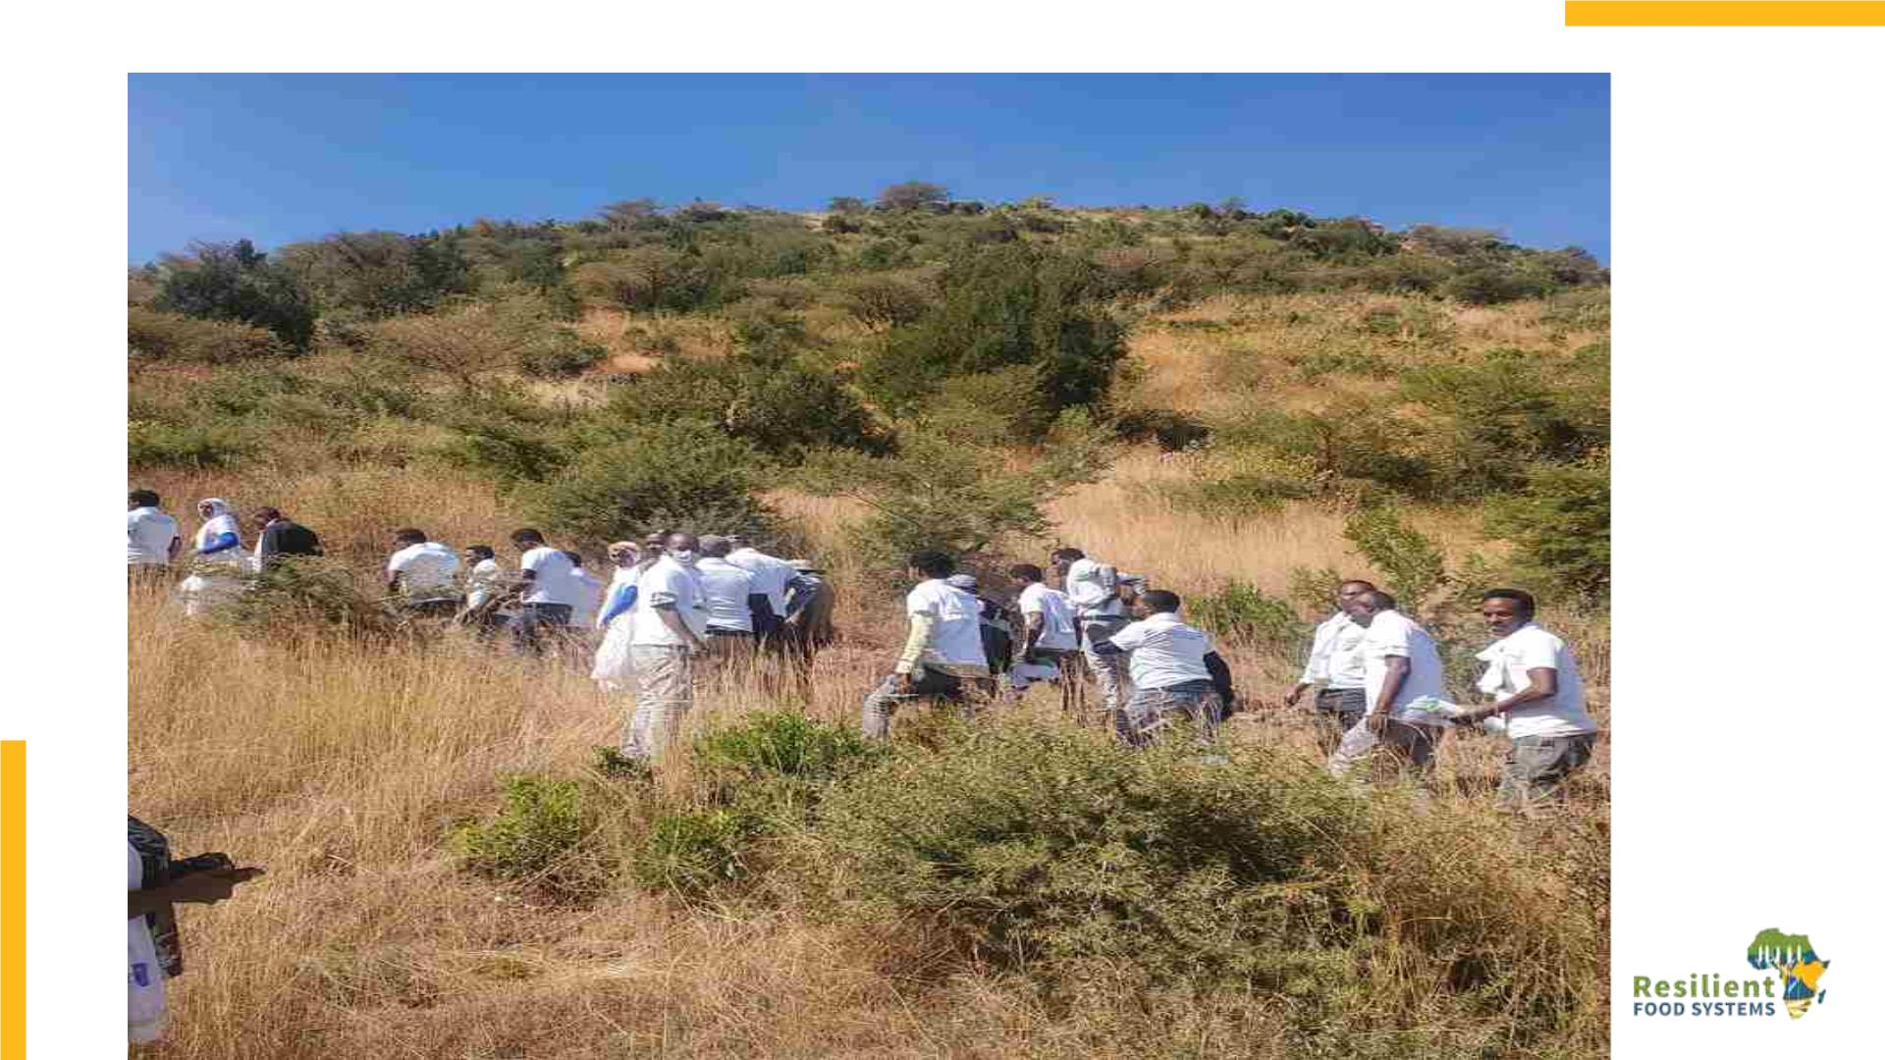

Slide 28
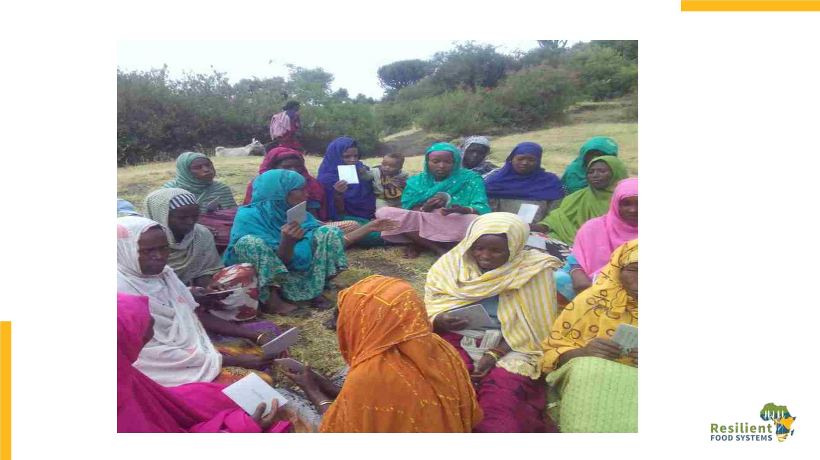

Slide 29
Experience Sharing
Based on your experiences with MSPs in
your context share:
• One objective for why you
established/supported MSPs,
• one key challenge and;
• one key lesson.

