Slide 1

Learning Lab 5: Advisory
services supporting
community innovations:
integrated landscape
management through FFS
and APFS

Slide 2
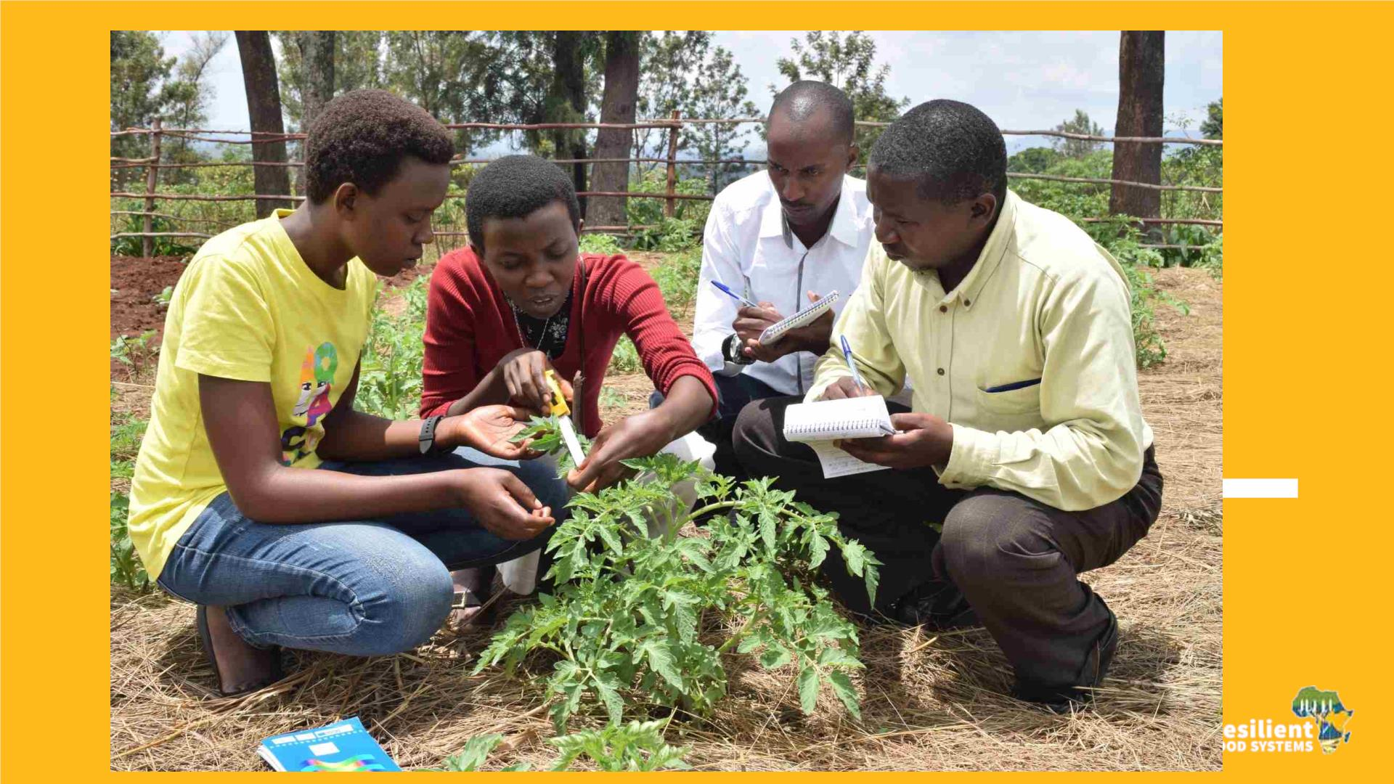

Slide 3
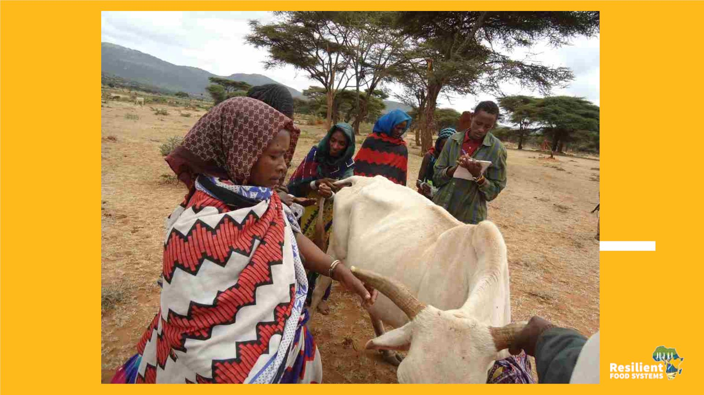

Slide 4
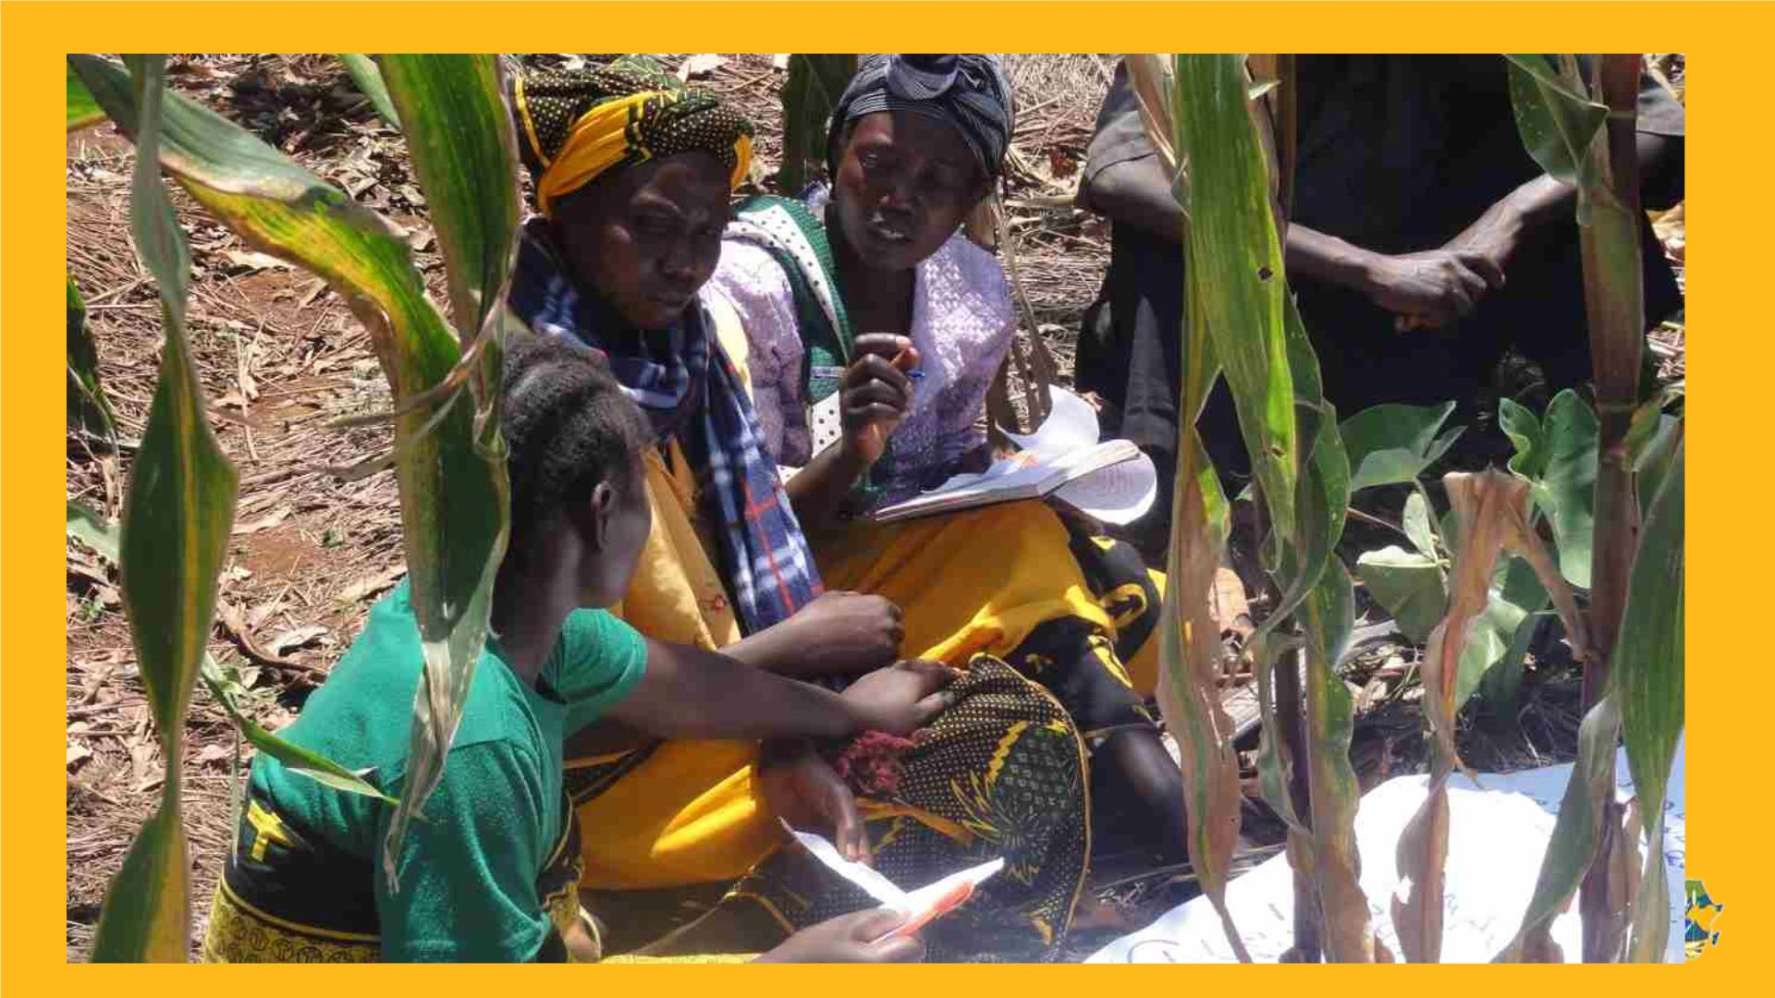

Slide 5
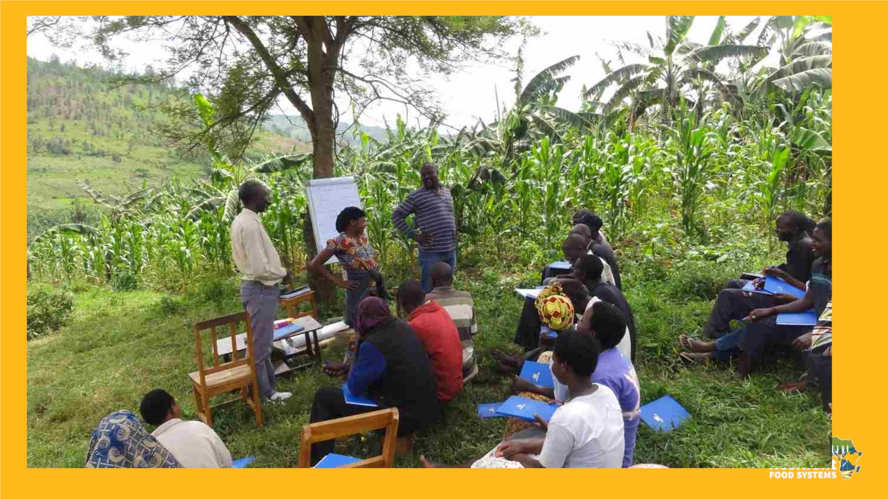

Slide 6
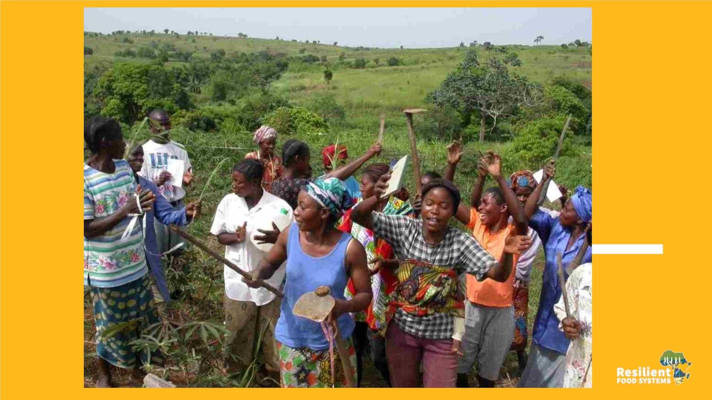

Slide 7

FFS in Uganda RFS
v Overall objective: Contribute to Enhancing Long-term
Environmental Sustainability and Resilience of Food
Production Systems in the Karamoja Sub-region.
v Outcome 2 (FAO): Increased land area and agro-
ecosystems under integrated natural resources
management (INRM) and SLM practices for a more
productive Karamoja landscape (ACT)
v Implemented 252 Agro-pastoralist Field Schools
(APFS) across 6 Districts, 7560 direct beneficiaries
v Some innovations tested in APFS: crop variety trials on
Groundnuts (Serenut 2 & Serenut 4); Beans (NABE 17
& NARO Bean 2).

Slide 8
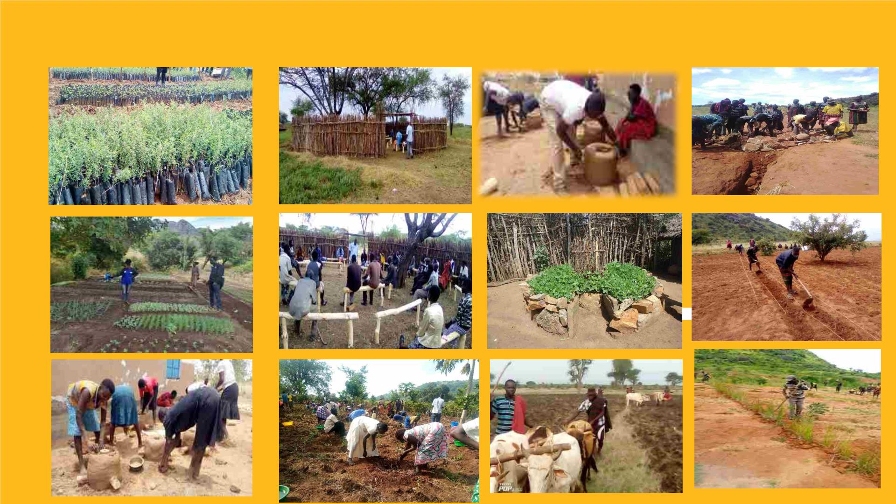
Sample of activities implemented under the project
INRM260 + 26ha APFS/FFS252 CSA252 SLM173.5

Slide 9
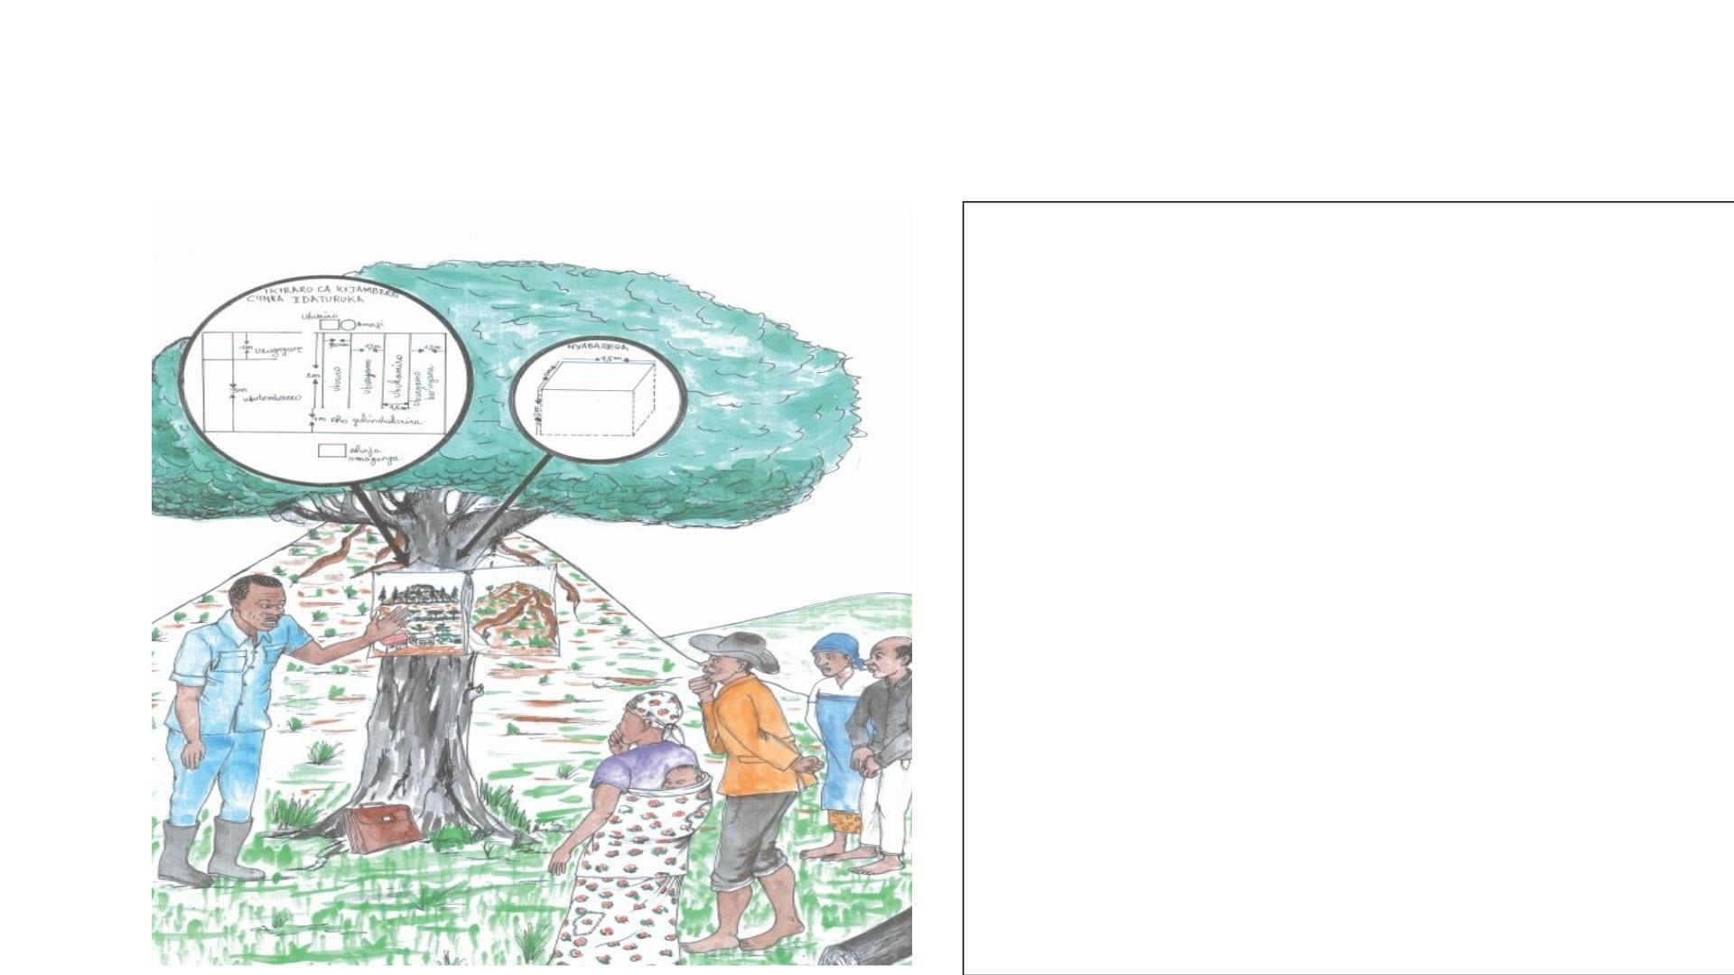
FFS in RFS Burundi
• CEP : 106 impliqués dans GDT
dans 9 bassins versants
• Superficie : 30 000 ha
• Technologies développées:
üFoyers améliorés,
ütechniques de compostage
amélioré,
üReboisement,
üAgroforesterie,
üIrrigation collinaire, SWC

Slide 10

FFS in Tanzania RFS
• Kondoa district
• 6 FFS setup:
• 2 FFS on conservation agriculture
• 1 Silvopasture FFS
• 1 pure stand pasture for rangeland improvement
• Alley cropping
• Contour
• Targeted groups/farmers: Subsistence farmers practicing mixed
farming system in degraded landscape ecosystems
• Focus on conservation agriculture practices to rehabilitate the
land

Slide 11
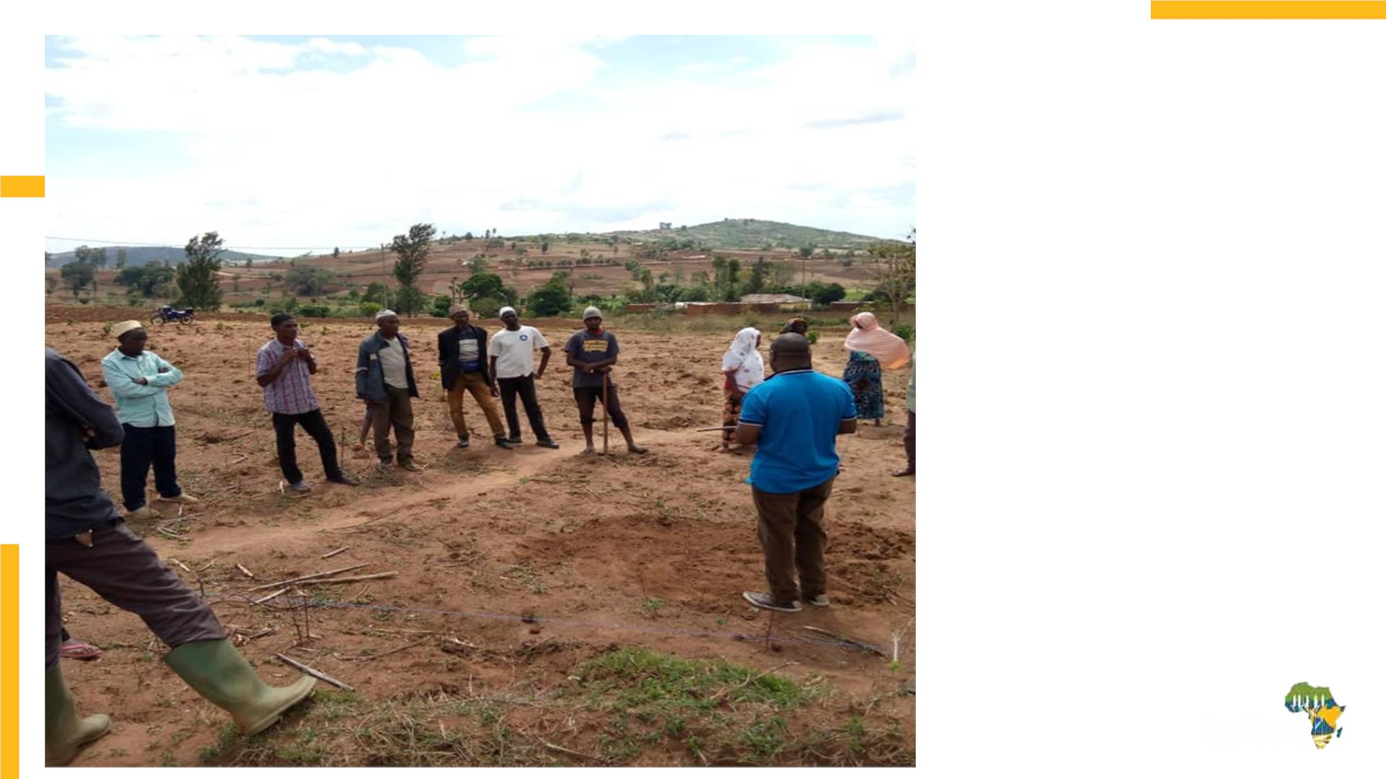
Tanzania
Engagement of Farmers
through on-farm hands-
on training to FFS group
members and interest
building for adoption of
CA innovations (9 seeds
and Zambian hoe)

Slide 12
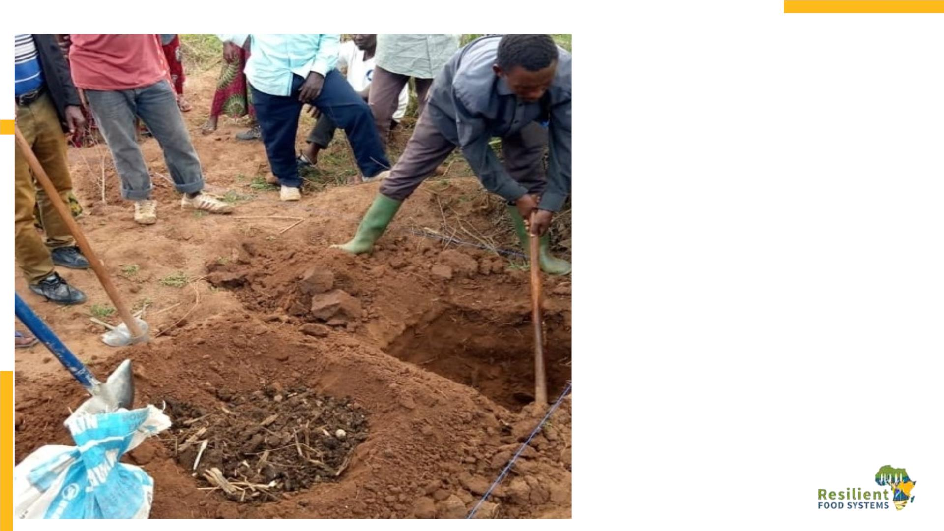
Tanzania
Experimenting with
CA practices in FFS
I
LAND PREPARATIONS FOR NINE SEEDS
( MBEGU TISA)
Square pits=60 cm height, 60
cm length and 60 cm width

Slide 13
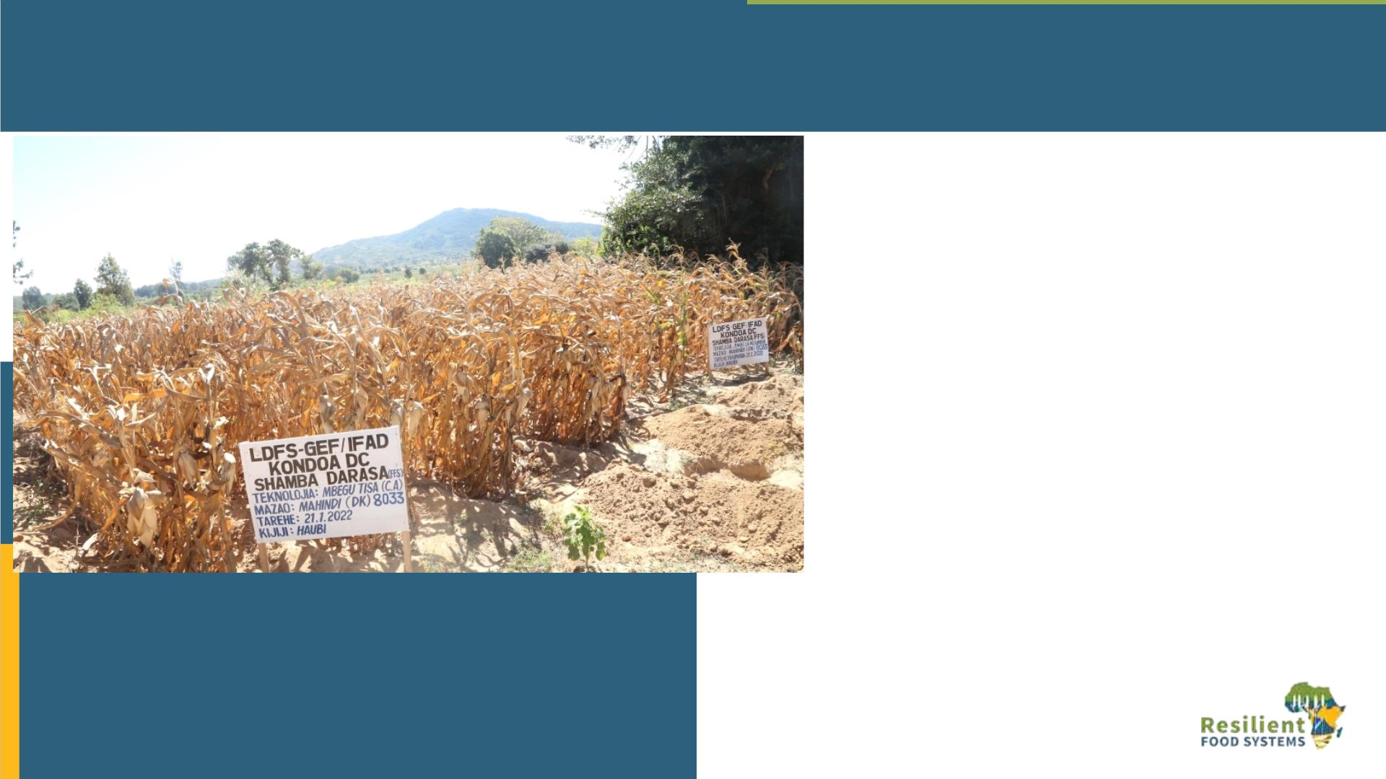
FFS allowed farmers to compare Mbegu tisa (Nine seeds pits) and traditional
practices in 2021/2022 rain season
Tanzania
Mbegu Tisa practice
• Length of the cob =18.75 cm
• Number of seeds per cob =463.25
• Area of 0.0344 Acre with 128 pits
=270Kgs
Traditional Practice
• Length of the cob =7cm
• Number of seeds per cob = 123.41
• Area of 0.75 Acre produce =62Kgs
Experienced drought in 2021/2022
with mount of rain (624 mm-in 41
days) versus performance of CA’s
technologies

Slide 14
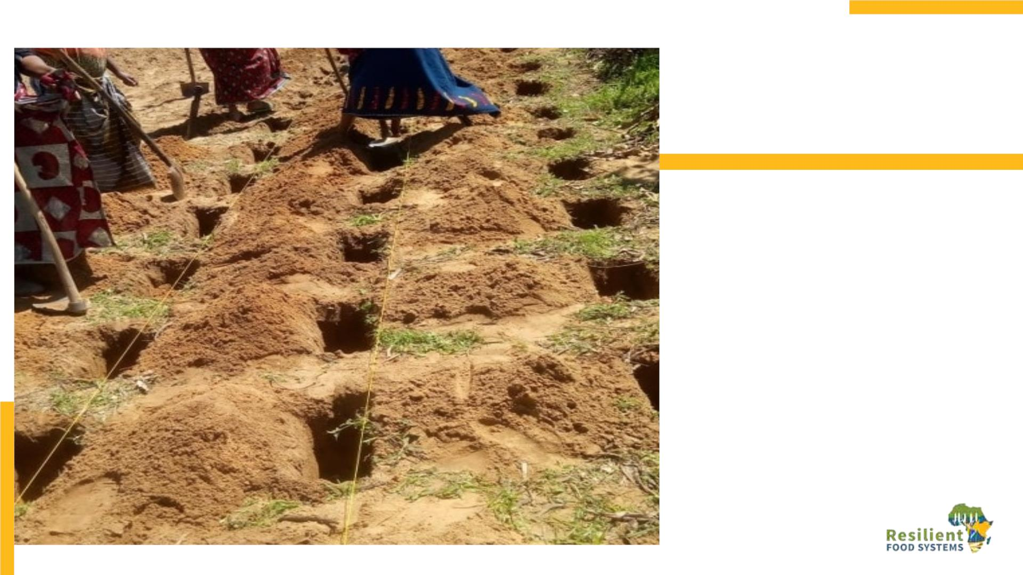
Tanzania
Sharing of identified
CAs innovations to FFS
-Groups
LAND PREPARATIONS FOR JEMBE LA
MZAMBIA PITS
Jembe la Mzambia= rectangle pits of
15cm width size of the hoe, 30 cm
length and 15 cm height.

Slide 15
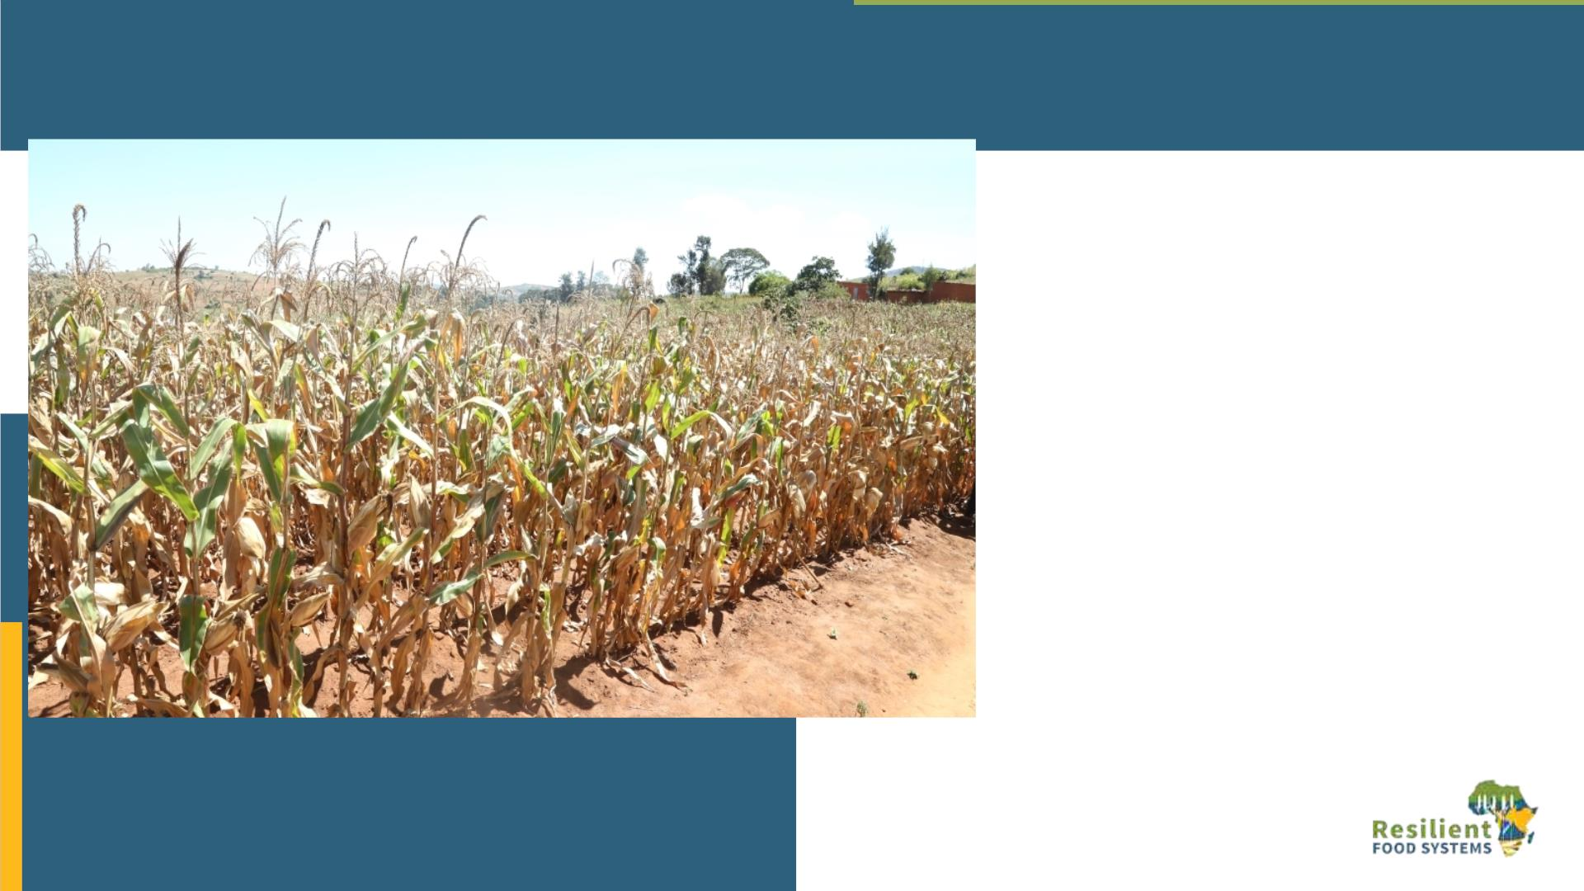
FFS allowed farmers to compare Jembe la Mzambia ( Zambian Hoe) and
traditional practices in 2021/2022 rain season
Tanzania
Jembe la Mzambia-Pits practice
Length of the cob =19 cm
Number of seeds per cob =421.6
Area of 0.2308 Acre = 670Kgs
Traditional Practice
Length of the cob =7cm
Number of seeds per cob =123.41
Area of 0.75 Acre =62Kgs
Experienced drought in 2021/2022 with
mount of rain (624 mm-in 41 days) versus
performance of CA’s technologies.

Slide 16
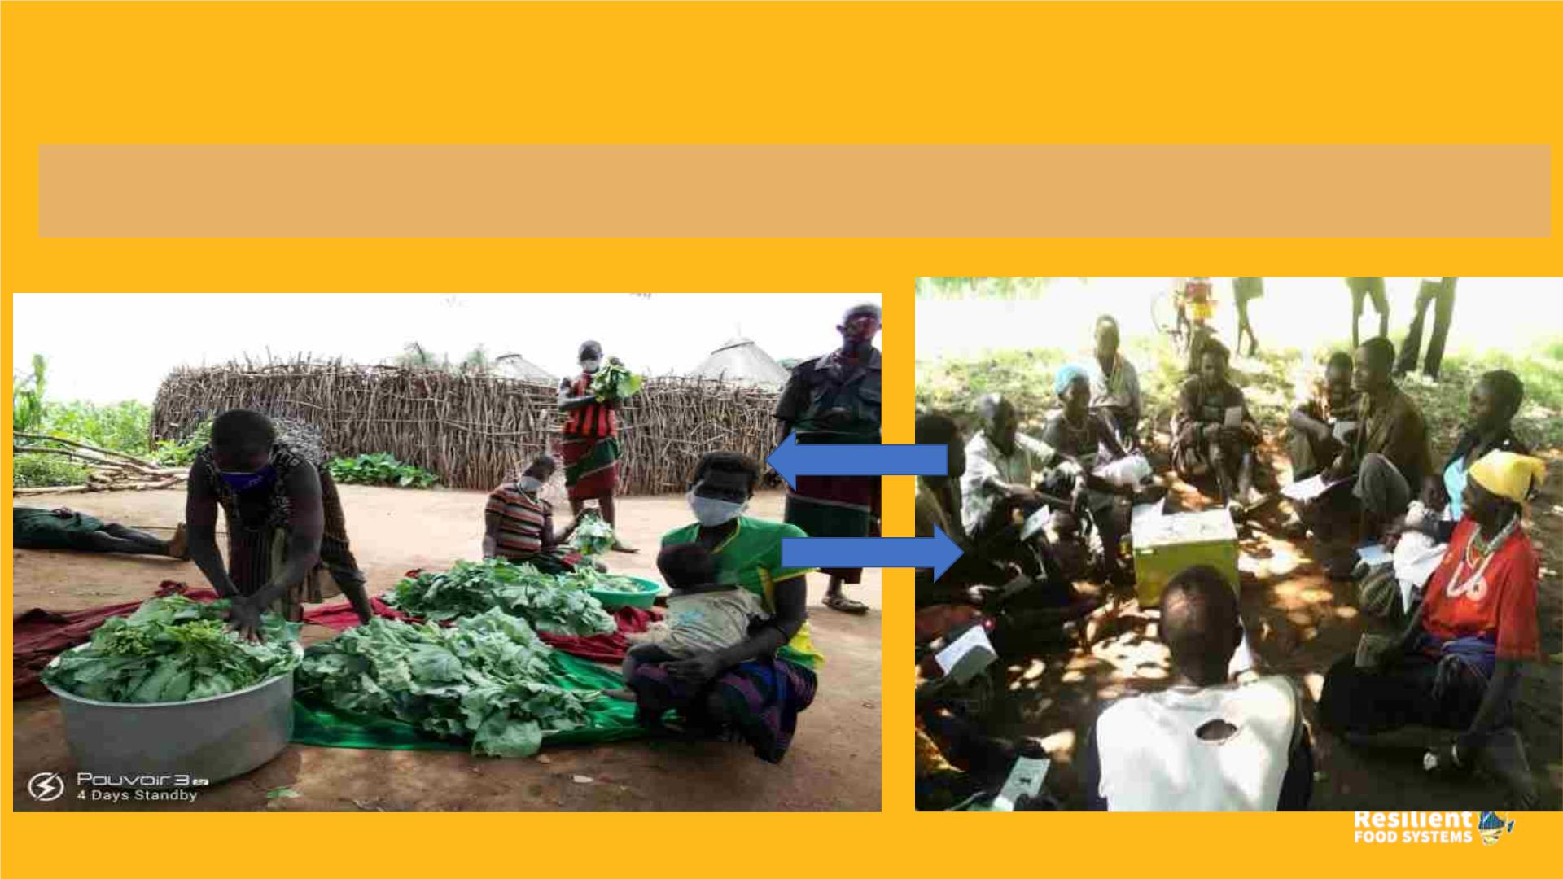
Uganda
Marketing of vegetables by APFS members in a nearby local market
VSLA sitting to do Savings, Loaning/Recoveries

Slide 17
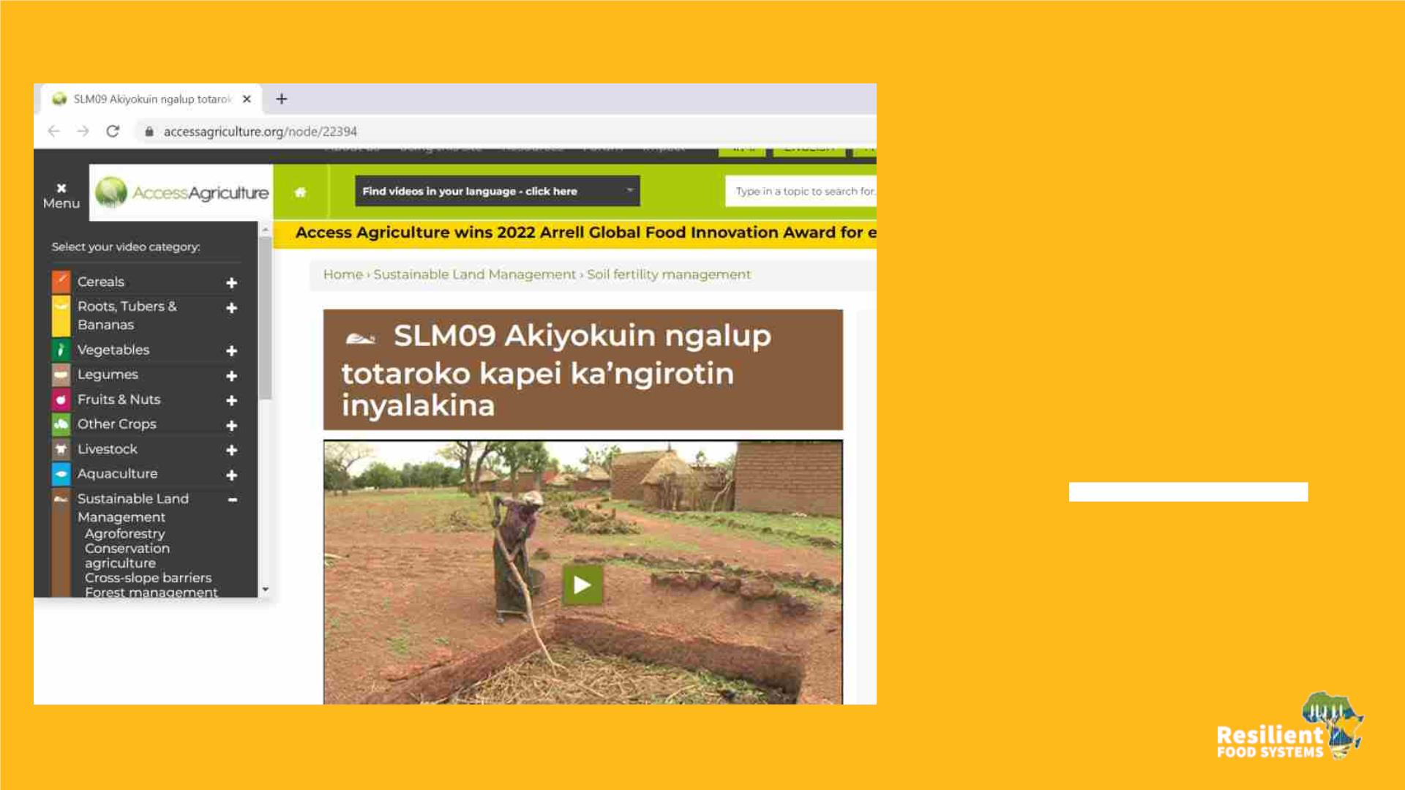
Uganda
• Collaboration with Access
agriculture (NGO)
• Making videos on INRM
based on FFS learning to
reach more farmers
• 20 videos

Slide 18
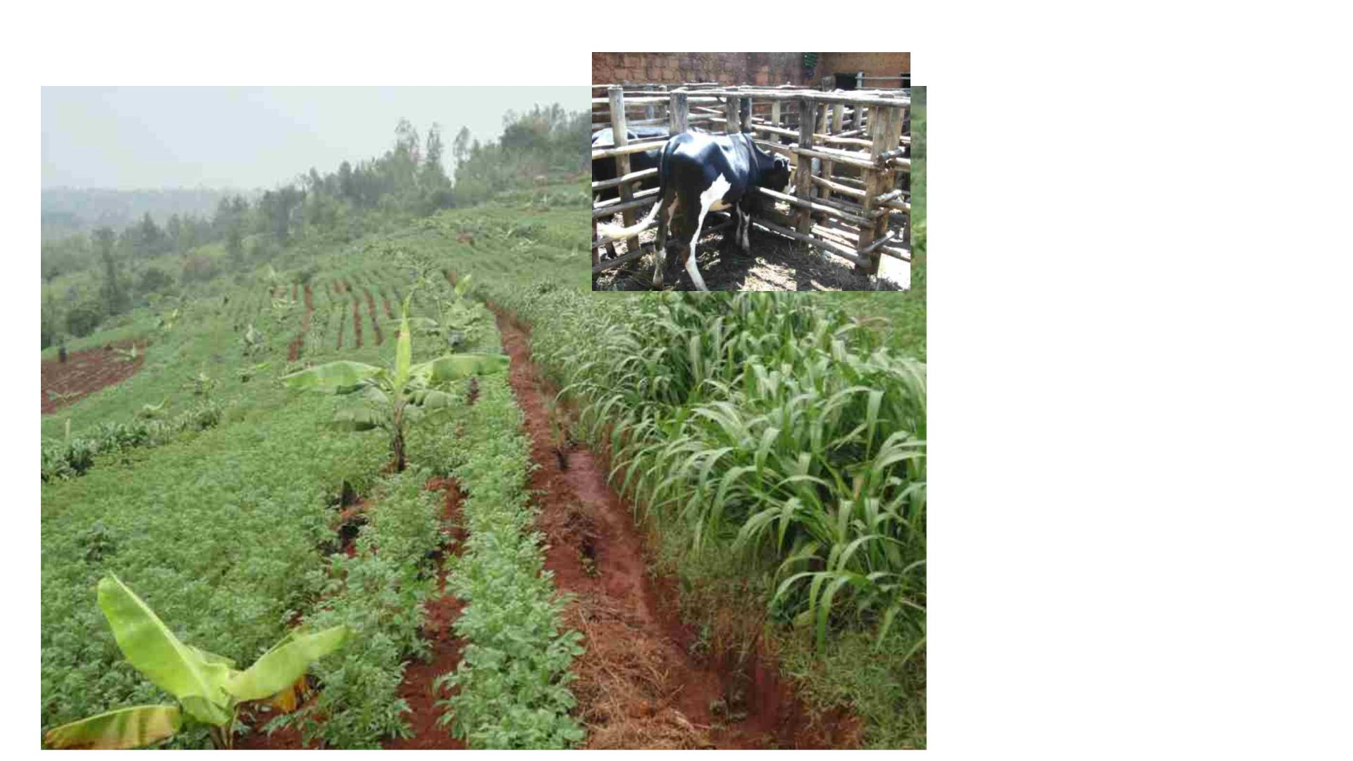
Burundi
FFS and integrated
landscape
restoration
• 106 FFS structured into 39
cooperatives
• Integrated watershed
management
• Agro-sylvo-zootechnic
integration,
• 09 sustainable value chains
developed,
• 106 resilient funds through
VSLA for self assisistance,
social cohesion, reduction of
lands conflicts,

Slide 19
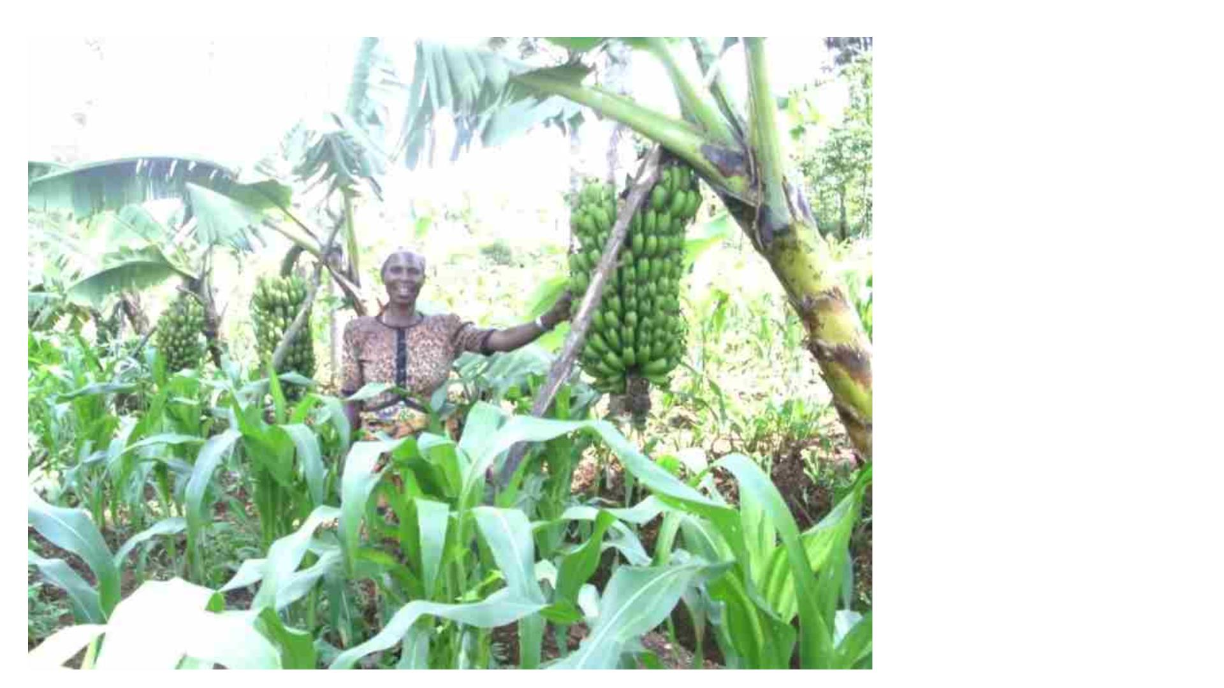
Burundi
FFS structured in
cooperatives around
sustainable value
chains
Maize and Banana
value chains to
increase incomes

Slide 20
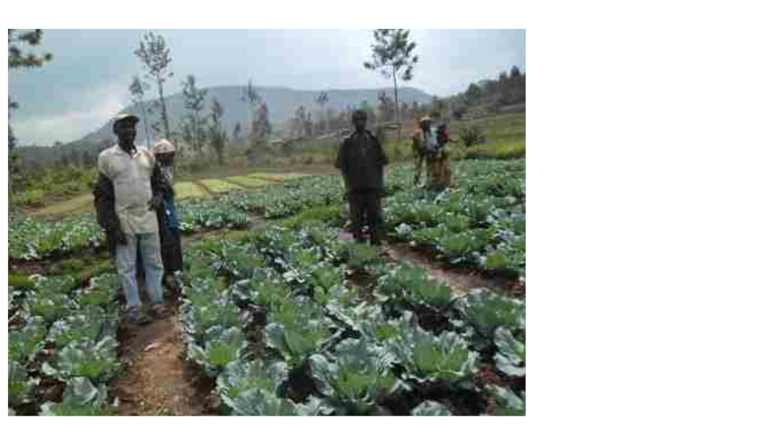
Burundi
Adaptation au
changement
climatique et
amélioration de la
sécurité alimentaire
Exemple de chaîne de valeur
adoptée par une coopération :
cultures à cycle court et à haute
valeur marchande.
Liaison avec des hôtels de la ville de
Gitega pour l’accès aux marchés.

Slide 21
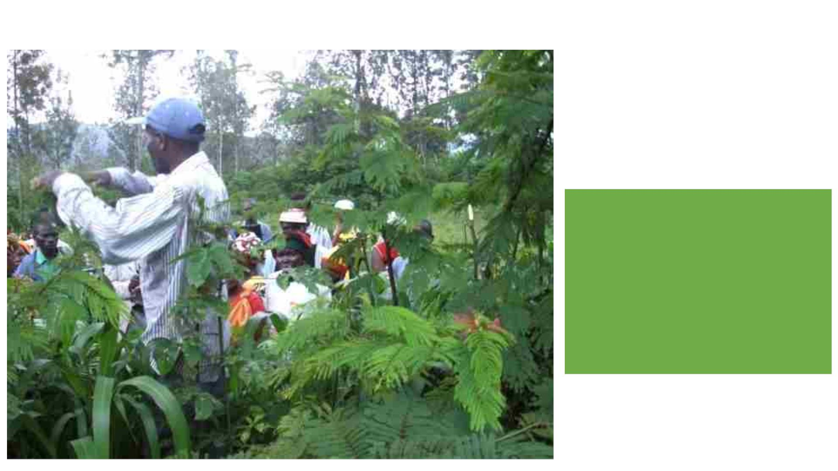
Burundi
Impact ecologique :
Restauration des paysages
dégradés par le reboisement,
l’agroforesterie, conservation
des eaux et sols au sein des
paysages

Slide 22
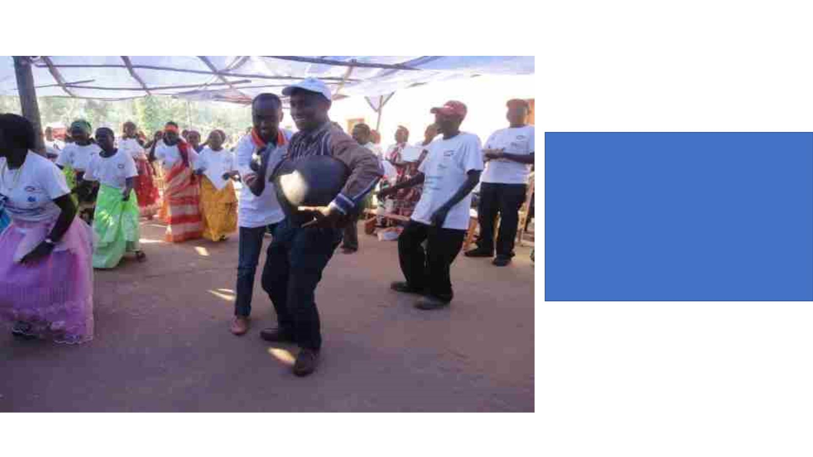
Burundi
Impact économique :
• Augmentation de la production
agricole orientée vers le marché ,
• Diversification des sources de
revenus non agricoles

Slide 23
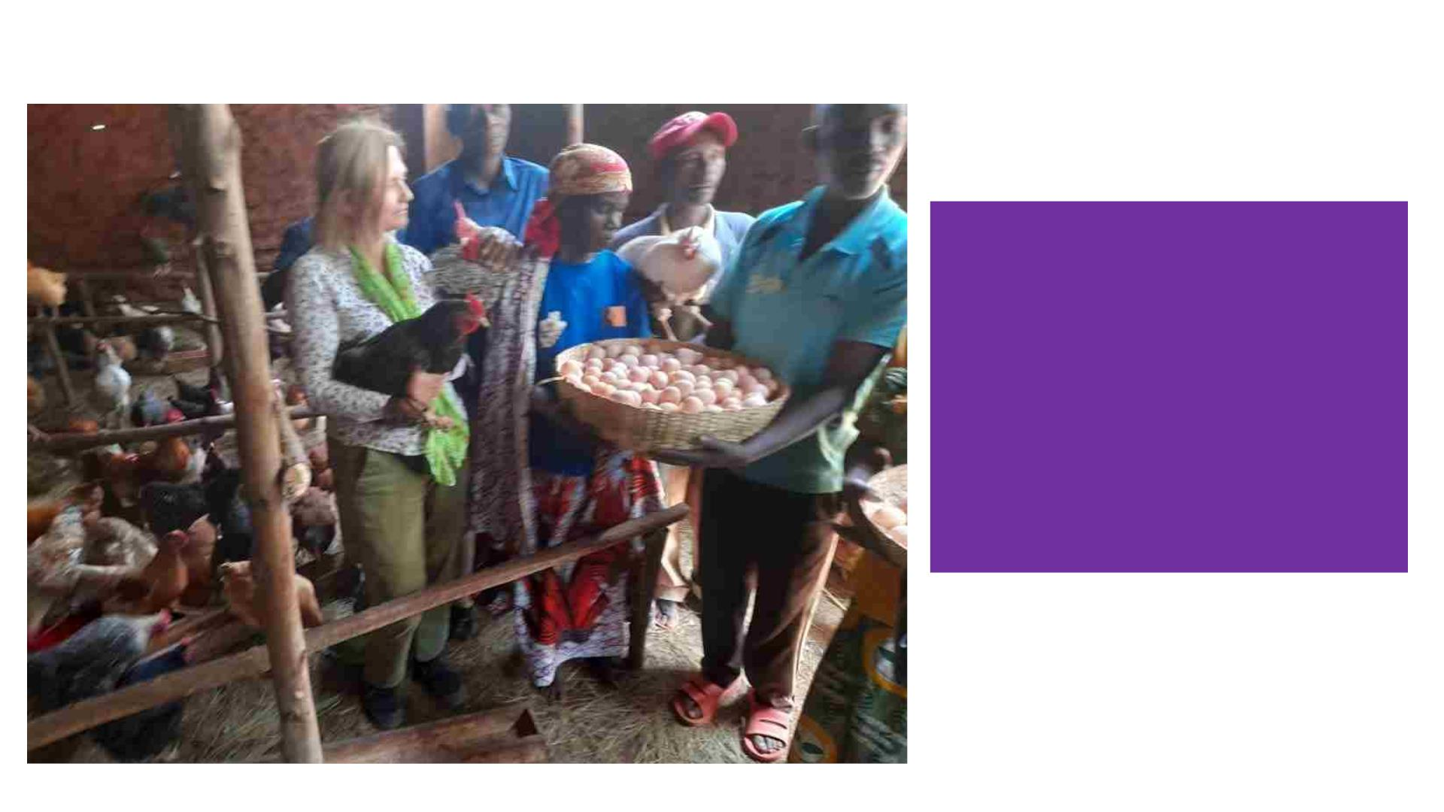
Burundi
Social :
• Chargement de comportement
des ménages : ne sont plus
attentistes, développement une
vision à long terme de leur avenir,
• Cohésion sociale et entraide
sociale,
• Réduction des conflits liés à la
gestion des terres

Slide 24
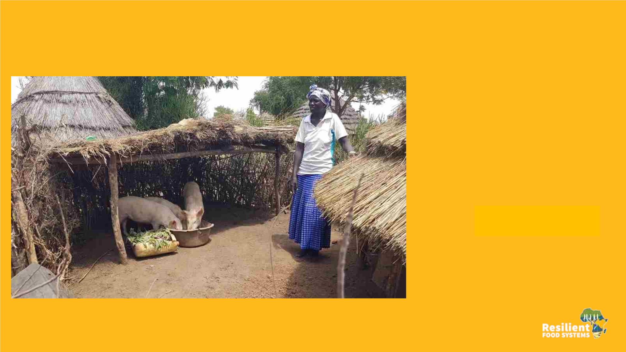
Impacts
Uganda
q A culture of savings and
investments among APFS
members and non-APFS
members.
q Food and income security
among APFS HHs has
greatly
–
members can pay school
improved
fees and
materials,
scholastic
acquire
productive assets, meet
medical bills, diversify diets,
etc.
q Gender and social inclusion
improved among APFS HHs.

Slide 25
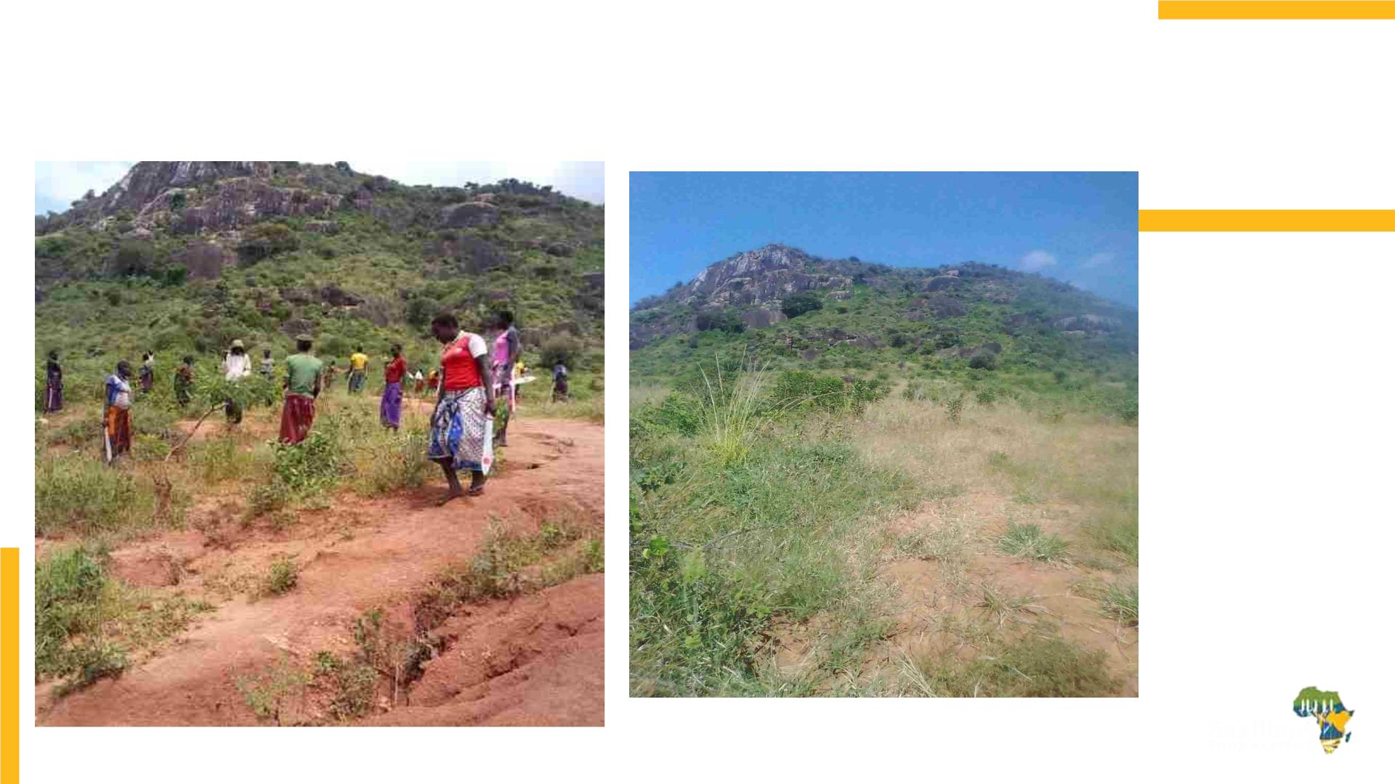
Uganda
Before rehabilitation Activity
After restoration activity
GEBs- at the
landscape level
- degraded
areas have
been
restored/re-
vegetated
through FMNR,
establishment
of community
woodlots, live
fencing,
making/use of
energy saving
stoves,
briquettes etc.

Slide 26
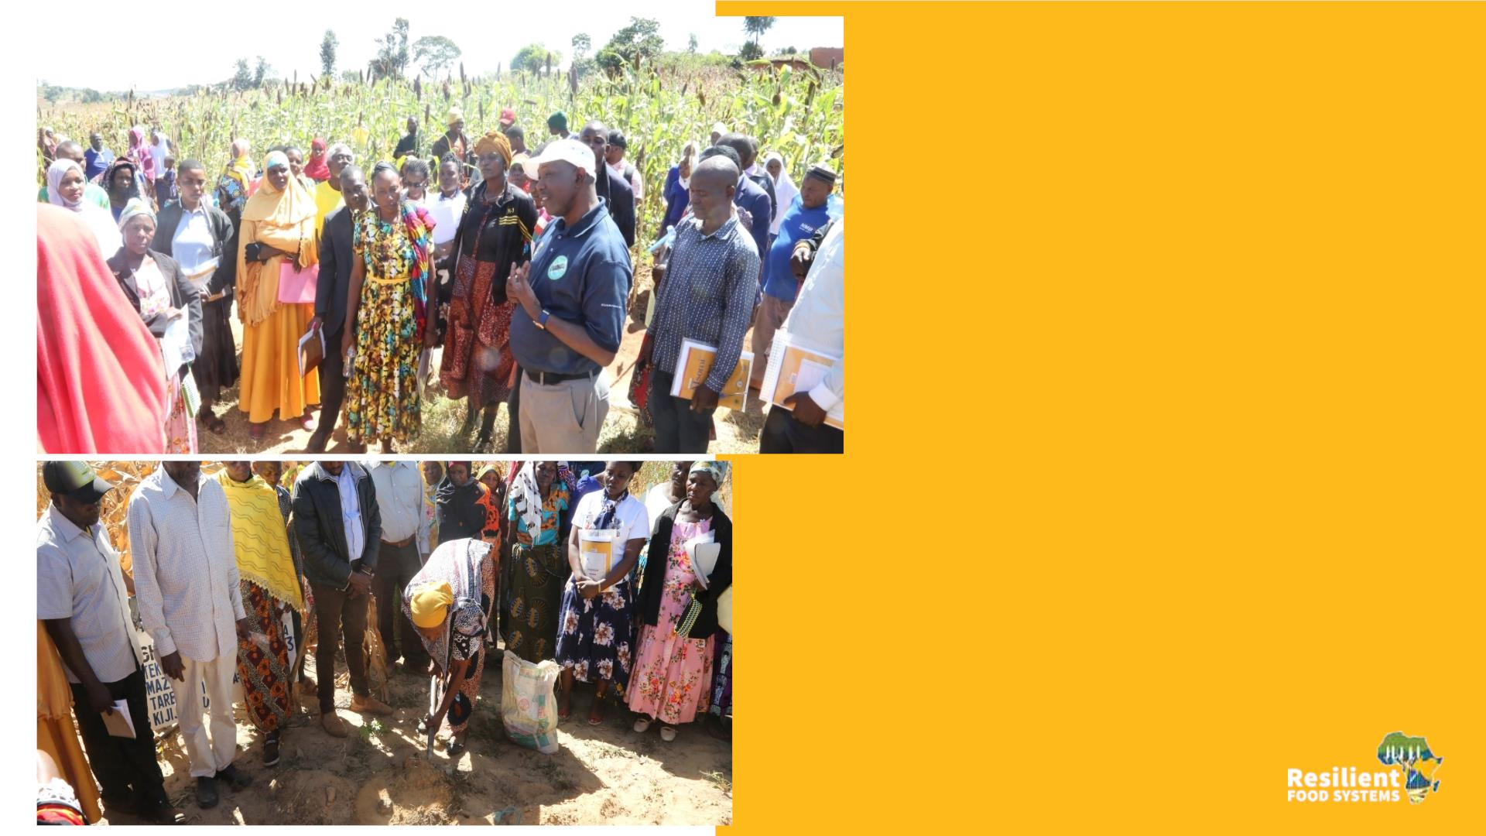
Tanzania
Innovation and
Knowledge sharing
Farmer-to-farmer exchange
visits of FFS between the
participating villages/districts
to showcase successful climate
smart adaptation practices

Slide 27
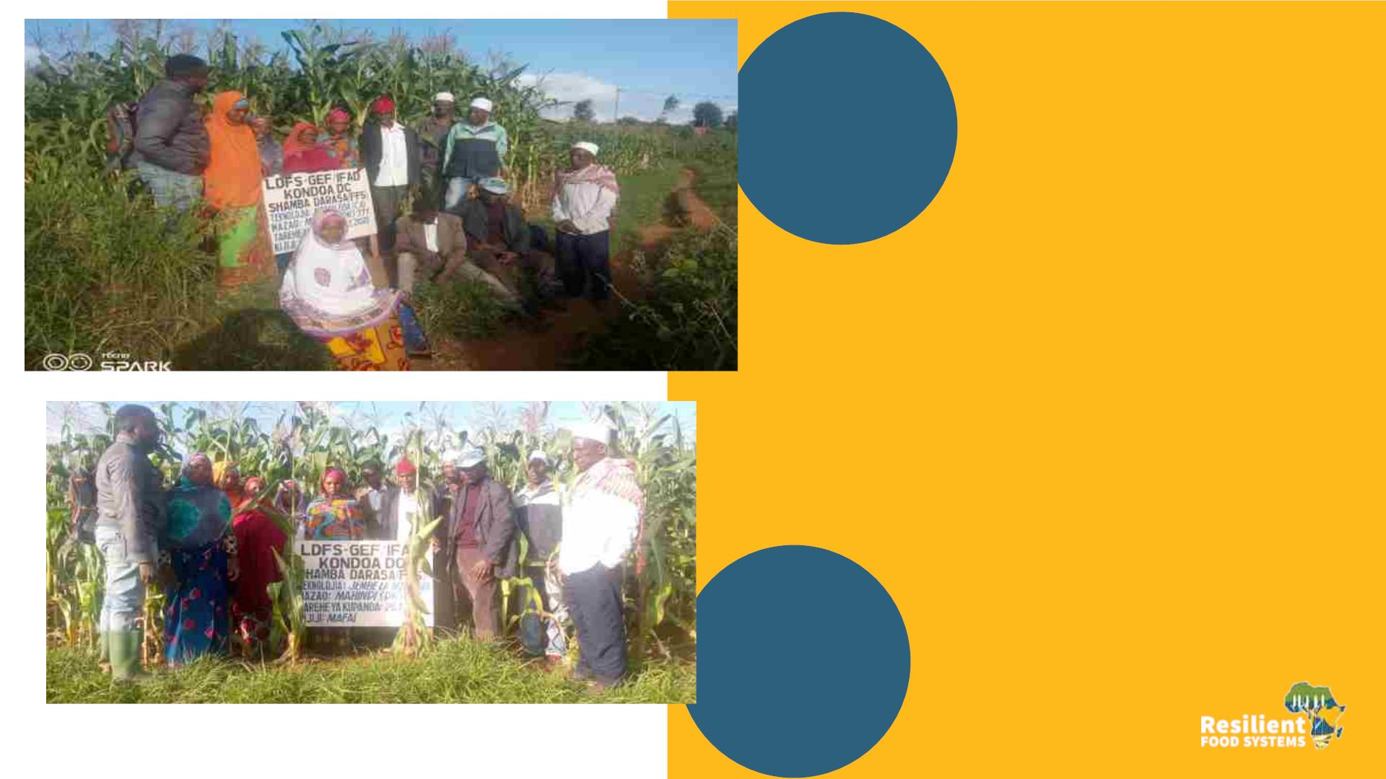
Tanzania
Nine Seeds
Plot
• The regional Secretariat/District
Management willingness for
upscaling of two innovations
after observed results.
• Developed plots experienced to
be Agricultural touristic area.
• Reduced water and soil run off
• Farmers join together to dig Nine
seeds and Zambian Holes) Pits.
Zambian Hoe
Plot
Drop off Farmers re-joining
Increased demand of Manure

Slide 28
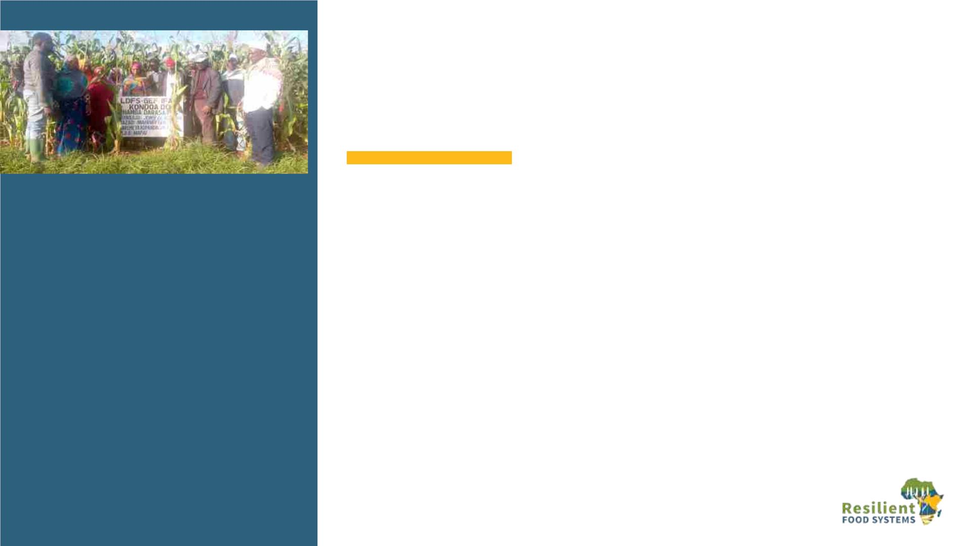
Tanzania
Lessons learned: Strategy and
sustaining of the innovations
• Encourage spirit of Working together/
Team work among group members
• Introduce dairy Cattle Keeping as
alternative source of manure and
income generating Activity
• Introduce Composite manure making
as business.
• Establish Junior Farm Field School in 5
Schools to Practice Nine Seeds and
Zambian Hoe Pits

Slide 29
Uganda
Lessons learnt
q Integration of the VSL mechanism with accompanying appropriate
value chain/IGA is key for sustainability and greater impact
q Experimentation is key for adoption and rapid uptake of production
and productivity enhancing technologies.
q Integration of Early warning/climate information into into APFS as
decision support tools enables farmers take anticipatory actions to
minimize the impact of shocks to their livelihoods.
q In the recent hunger crisis in the region- Early warning information provided
monthly through Drought Bulletins together with IPC report warned of an
impending/looming hunger which allowed HH to buy and stock grain to bridge
the hunger gap to the next harvest.

Slide 30
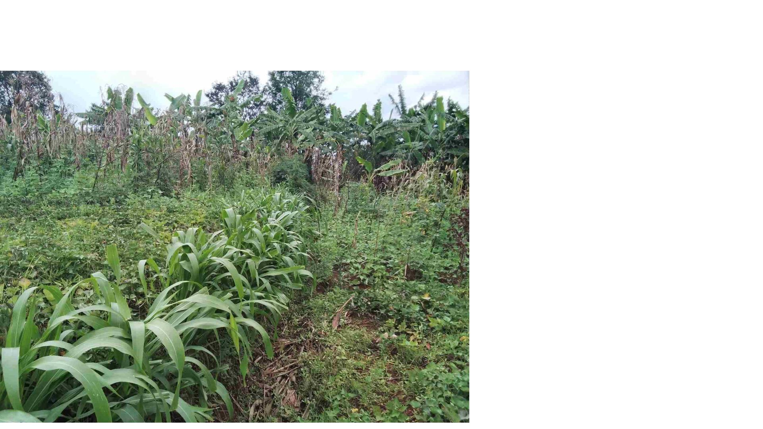
Burundi – lessons learned
Implications des structures
pérennes du Gvt à tous les niveaux
est une voie de durabilité
Evolution des CEP en coopératives :
une voie incontournable pour une
restauration intégrée des paysages
et sécurité alimentaire,
Des journées portes ouvertes :
influencer l’adoption des approches
et technologies adoptées,
Restauration des paysages :
approche multidisciplinaire et
multisectorielle

