Slide 1

Learning Lab 6
Addressing learning and adaptive management at the RFS
Malawi, Kenya, IFAD, ICRAF

Slide 2

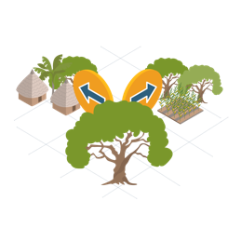

What is adaptive management ?
Engage
An ongoing process of planning, implementing, assessing, learning and adapting, in the face of uncertainty, with an aim to reducing uncertainty over time via system monitoring.
Project implementation is done by applying what was learned to the next phase of a management process.
It is a flexible decision-making process enabling a project to be adjusted as the results of various actions become better understood = “learn while doing”
This approach encourages innovation and experimentation, links science to decision-making and improves long-run management outcomes.
The “tracking” informs the “acting”.
Such a culture of learning leads to increased knowledge, better practices, and improved results.
Act
Track

Slide 3
Adaptive management can take place…
Gradually, as opportunities for improving delivery are identified based on the reality of the field or to overcome design shortcomings
FAO contributions to Component 3 of the Regional Hub, on monitoring of food security and resilience.
ICRAF contributions to Component 1 on bridging the gap between Science and Policy and advocating for resilient food system through the SHARED approach.
Or suddenly, as the result of external shocks, often massively disruptive
COVID-19 forcing faster adoption of digital technologies and new ways of reaching out to beneficiaries across the RFS portfolio.
  [SHARED = StakeHolder Approach to Risk informed and Evidence-based Decision-making]
Notes:
FAO had no responsibility (nor corresponding deliverables) attributed at design to component 3 of the Regional Hub project - monitoring and assessment of ecosystem services, global environmental benefits and resilience.
Thanks to constructive engagement and dialogue, the FAO team agreed to play a part in this component, by overseeing a newly created output (3.4.1. All countries are monitoring interventions on food security and resilience on target populations), despite not having a pre-existing dedicated budget to do so.

Slide 5
Country case studies
Malawi

Slide 6
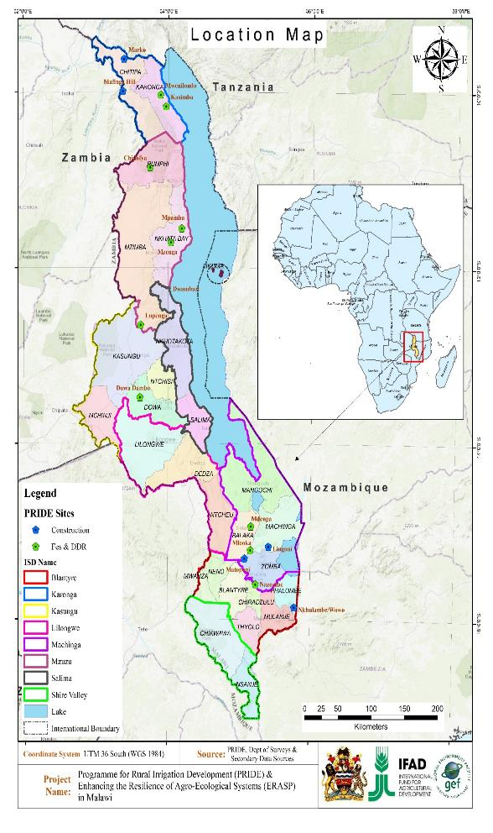

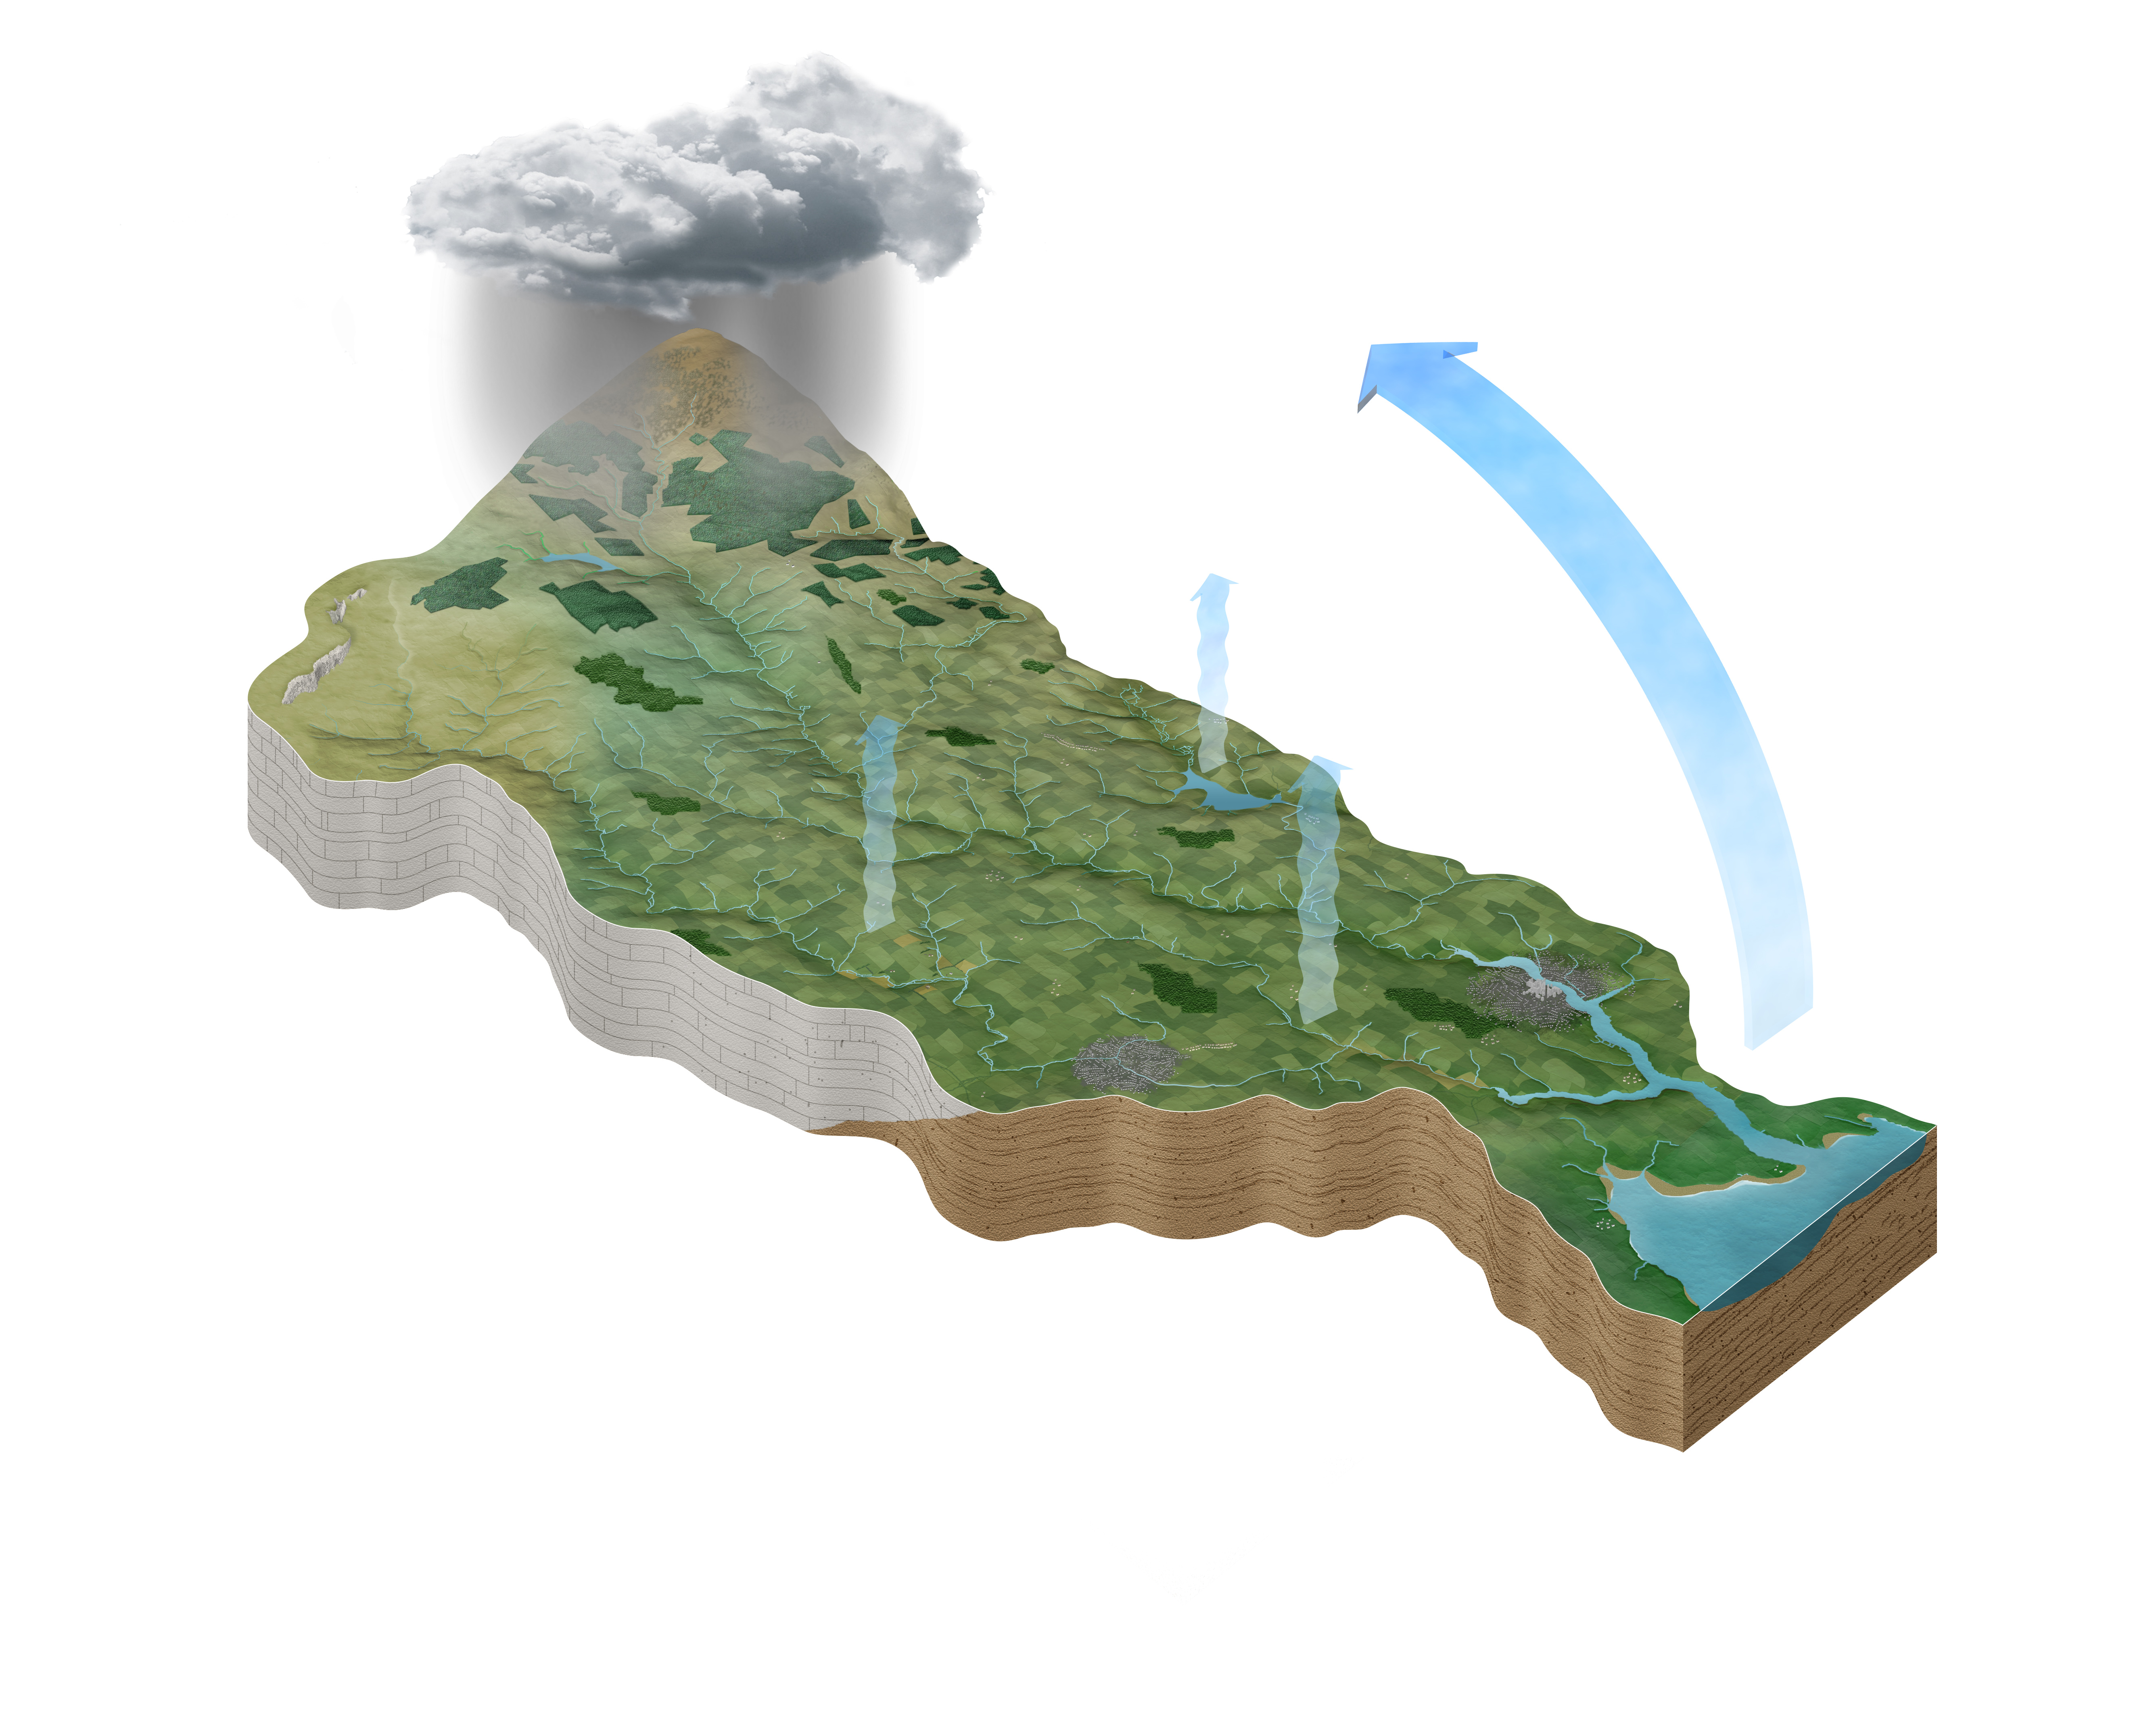
Enhancing the Resilience of the Agro-ecological Systems Project (ERASP) design intent
ERASP aims to promote resilience and sustainable management of ecosystems and to climate proof food production systems.
ERASP is prioritizing investments in wider catchment area management, increasing ecosystem service and the sustainability and benefits from the Program for Rural Irrigation Development (PRIDE) investments in four most vulnerable water resource units (WRUs) in Karonga, Machinga, Phalombe & Dowa.
ERASP targets 32100 households.
ERASP investments
PRIDE Investments

Slide 7
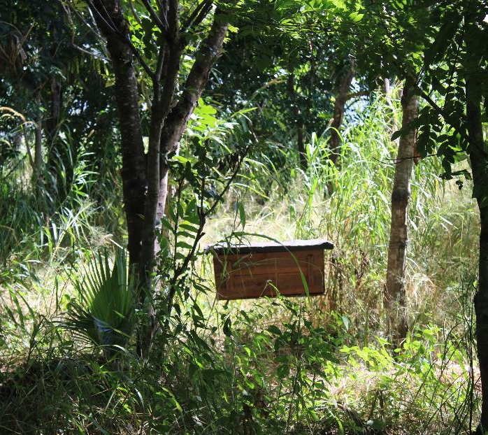
Adapting to uncertainty
Differentiated benefits for farmers in low and upper catchment areas
Low rate of adoption - few people actively participating in the catchment management activities outlined in the Village Level Action Plans (VLAPs) because catchment interventions are labour intensive (e.g. swales, gully reclamation works, contour ridging, vetiver planting) and they don’t perceive benefits.
Came up with incentives that came to ensure farmers from upper catchment would also benefit – to motivate farmers to participate in labour intensive catchment management activities.
Initiating competitions and rewards (materials for catchment management + livestock pass-on) to communities that out-compete others in catchment management as per VLAPs and also targeting such populations in livestock pass-on.
Bee keeping start up equipment in all targeted sub-catchments (recipients are then responsible for subsequent bee-keeping investments)
A bee-hive at Lingoni in Machinga district – a viable non-timber forest income source.

Slide 8
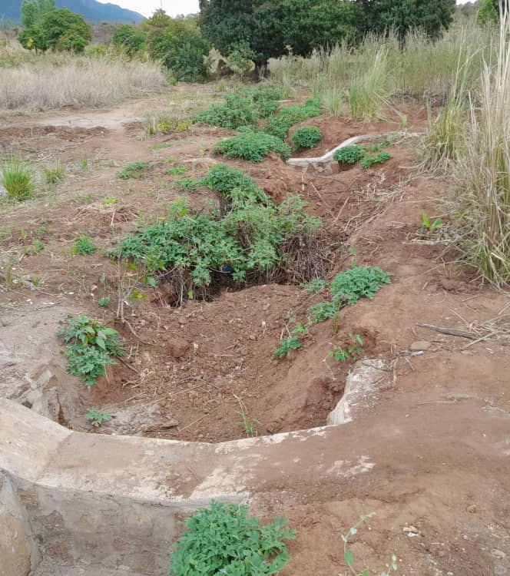
Decision making process for adaptive management
The project involves various stakeholders, and decentralized partners which provide policy and technical guidance during planning and implementation i.e., Central & Local govt structures, Local Authorities, Catchment Management Committees (CMC), Village Natural Resource Management Committees (VNRMCs).
Project works in close collaboration with national implementation actors – the issues were identified jointly.
PCO and implementing stakeholders motivated for greater budget allocation to catchment management activities.
Participatory process in identifying the incentives to benefit the upper catchment.

Slide 9
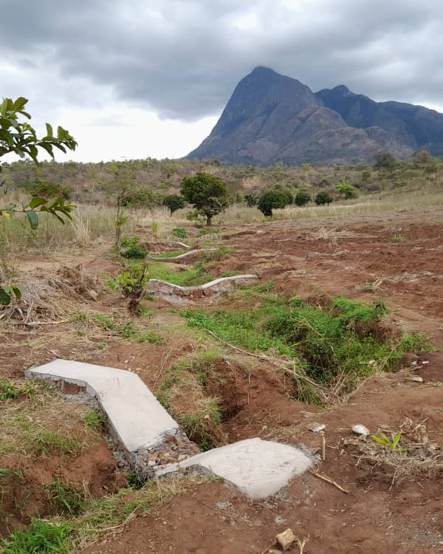
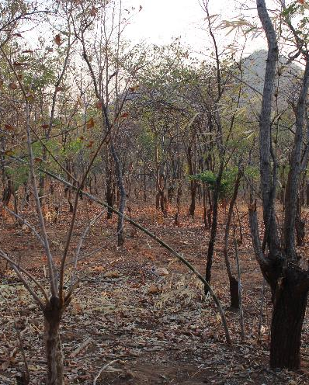
Project monitoring & evaluation for adaptive management
MEL system helps to identify project uncertainties and come up with innovations and/or incentives to act as motivation factors hence increasing adoption of intended practices
E.g. bee hives - linked to forest + we can see room for improvement : start on a large scale so as to make benefits quickly visible
Village communities, chiefs & agricultural extension services involved in monitoring programme activities – custodians of continuity of the incentive mechanism introduced
Compilation of Best Practices manuals that capture such adaptive management so as to inform similar programmes in future.
Gully reclamation at Wowo in Phalombe
Forest regeneration is helping reclaim degraded forests

Slide 10
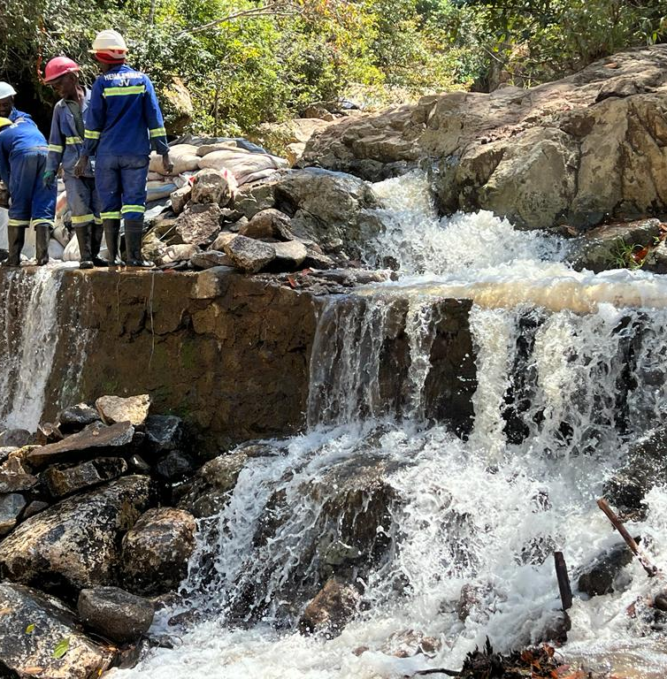
Outcome of the adaptive management process
Increased adoption of the catchment area management activities.
10781 Hholds (3499F, 7282M) = 33.59% of the target. Restored 1986.9ha of degraded agricultural land.
Higher yields due to higher water retention and increased nutrient levels as a result of reduced soil erosion and runoff
Mean Lean Periods (Months)
PRIDE Beneficiaries =3.3 months
ERASP Beneficiaries = 4.2 months
Control Group = 5 months

Slide 11
Country case studies
Kenya

Slide 12
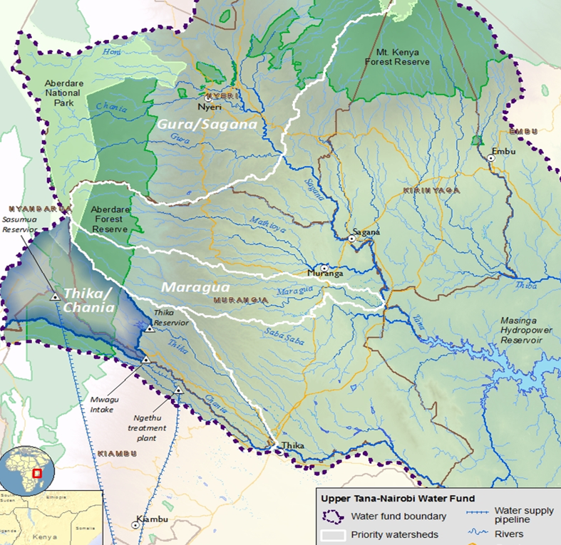
Project design intent
5-year programme (Oct 2016- Dec 2021)
MPAT BL 66.6; Endline 70.5. Six (6)% improvement of overall status & wellbeing of communities
Support >21,000 smallholder households = Achieved 51,400
Improve management of 100,000 Ha = Achieved 77,401
Water fund platform operational = Achieved - Governance in place, capitalized with USD2.4; USD 600k pledged and USD 1 M match funds
GHG emissions avoids BS 1.6 M ton = End-term 5.8M ton co2 equivalent
Lessons learned out-scaled target 2 = Achieved 3 in Kenya and Over 10 in Africa

Slide 13
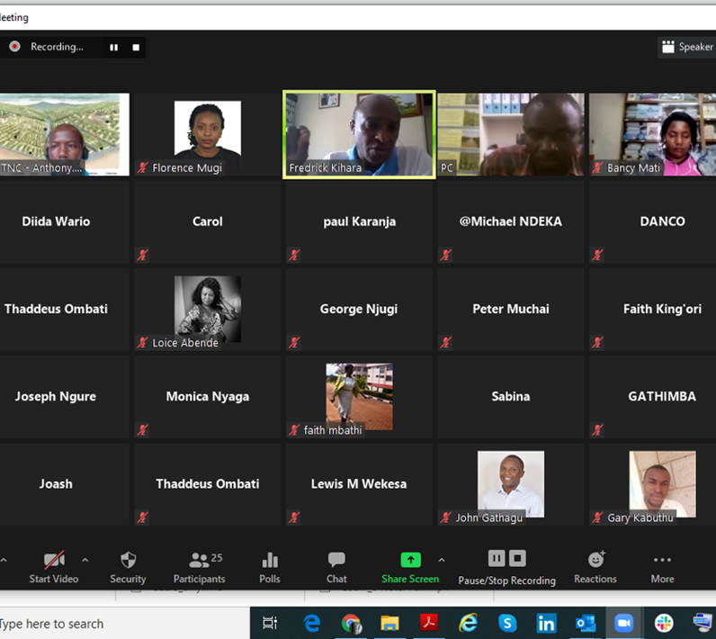
Adapting to uncertainty
Covid – 19 declared a pandemic in Kenya (March 2020)
Cessation of in person meetings, restriction of movements/field travels
Demobilisation of field teams: 2021 March – May planting season disrupted
Unforeseen challenges in farmer mobilisations, trainings, field monitoring, conservation materials procurement and distribution etc
Project deliverables and timelines were tightly linked to post project transition and sustainability

Slide 14
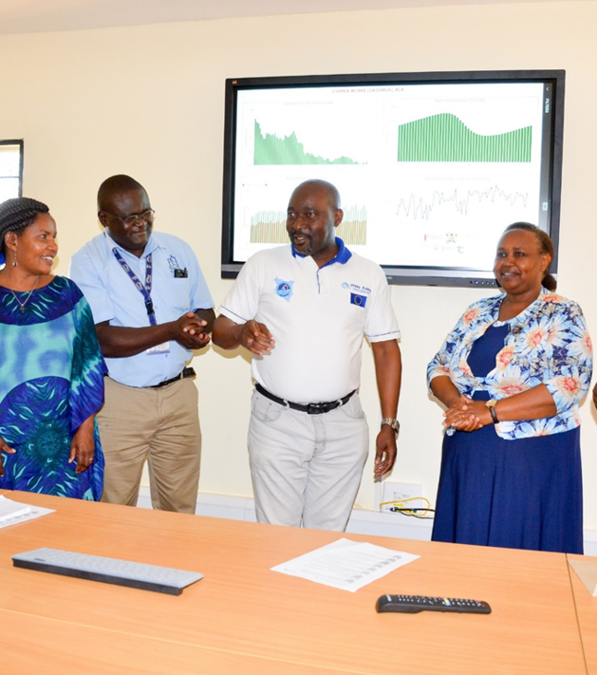
Decision making process for adaptive management
Decision – All governance, team planning and partner meetings shifted to virtual and farmer engagements through SMS platform (follow ups, demand creation, advisories, surveys etc)
Stakeholder engagement/advocacy and how hurdles were overcome
Governance and Partners – Agreed timelines and deliverables to be respected as practically feasible under the pandemic. Provided Incentives for internet bundles/airtime in lieu of travel and per diems' reimbursements. Enhanced data sharing and visualization with dashboards based on Power BI.
Farmers and service providers – adopted SMS platform as the main medium for outreach and monitoring of field activities. Currently 78,000 farmers registered and disaggregated by interventions, outreach and type of information needed.

Slide 15
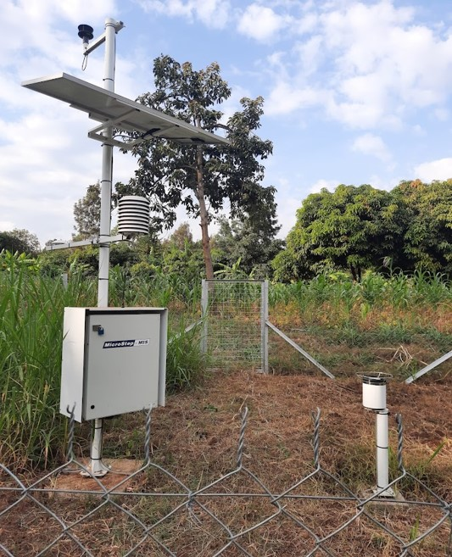
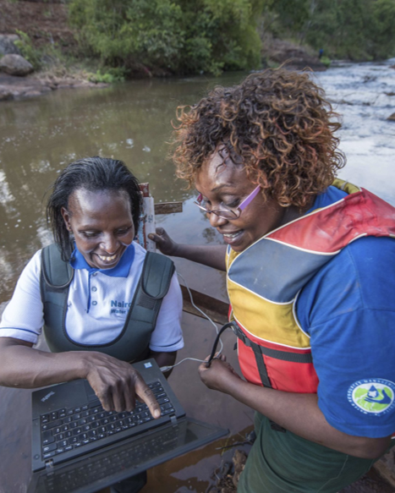
Project monitoring & evaluation for adaptive management
A robust and detailed high-quality monitoring and evaluation plan (MEL system). Cloud based and follows a theory of change
Relational databases for the management of socio-economic and hydrometeorological data
Shift from DHIS to Google sheets for field data capture and uploading to database (more versatile with low tech cell phone handsets)
Integration of Power Bi to enhance data analytics and visualization
MEL lesson replicated in the set up of Eldoret – Iten Water Fund

Slide 16
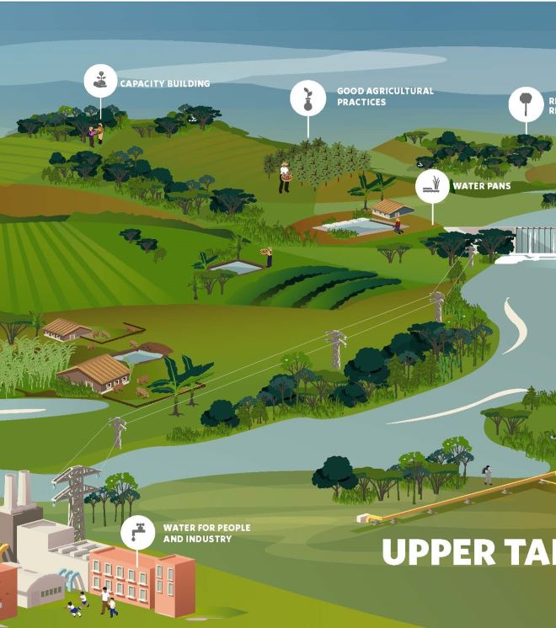
Outcome of the adaptive management process
Going Virtual – Governance meetings recorded 75 – 100% participation. More efficient and effective participation of volunteer leaders.
Conservation targets – All targets were exceeded except hectares under SLM practices (77.4%). More funds devoted to inputs as “processes” became mostly remote mode.
Monitoring and data analytics – integration of ICT exceptionally improved remote data collection, storage, analysis, and visualization. Near real-time data and information for decision support.
Strengthening Partnerships and collaboration – digitized data, information and reports liberalized data and information sharing enhancing trust among stakeholders (public and private partners).

Slide 17

Questions or comments ?

Slide 18
Interactive exercise
What examples do you have of adaptive management from your project?
Quels exemples avez-vous sur la gestion adaptative dans votre projet ?

Slide 19
